Slide 1
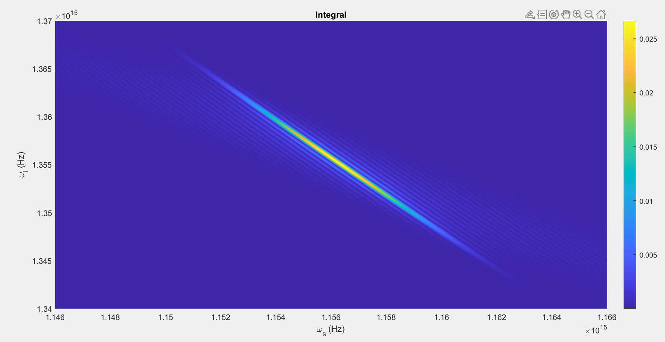

Slide 2
Parameters:
T = 80ps
Beta_f2 = 0.0083 ps^2/cm
Beta_s2 = 0.0022 ps^2/cm
Beta_p2 = 0.0253 ps^2/cm
Beta_f1 = 5.633 ps/cm
Beta_s1 = 5.333 ps/cm
Kappa = 6900, 1/cm
Gamma = 10^1.5, 1/(cm sqrt(kW))
C = 1, 1/cm
A = 1kW
Pulsewidth = 10ps
U0 = Real

Slide 3
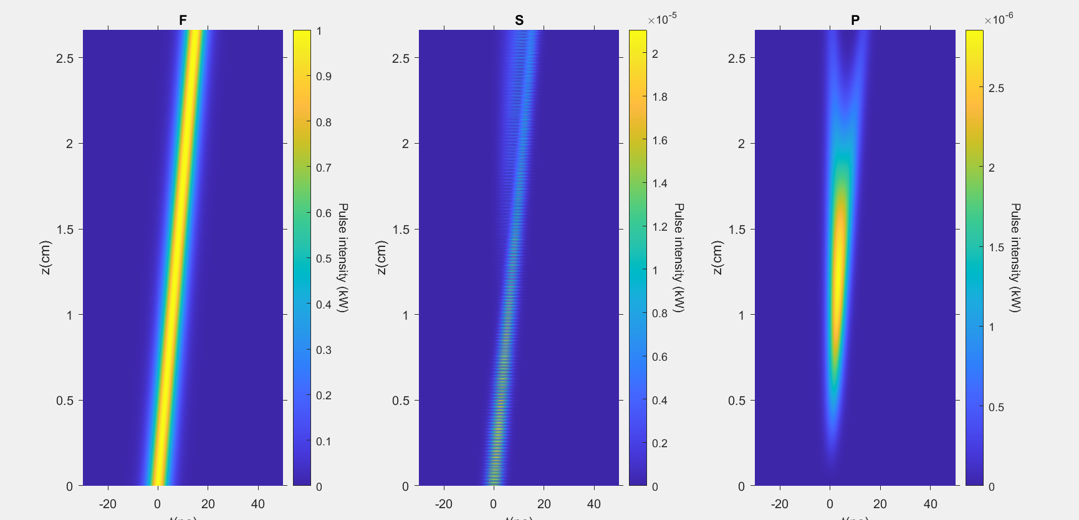

Slide 4
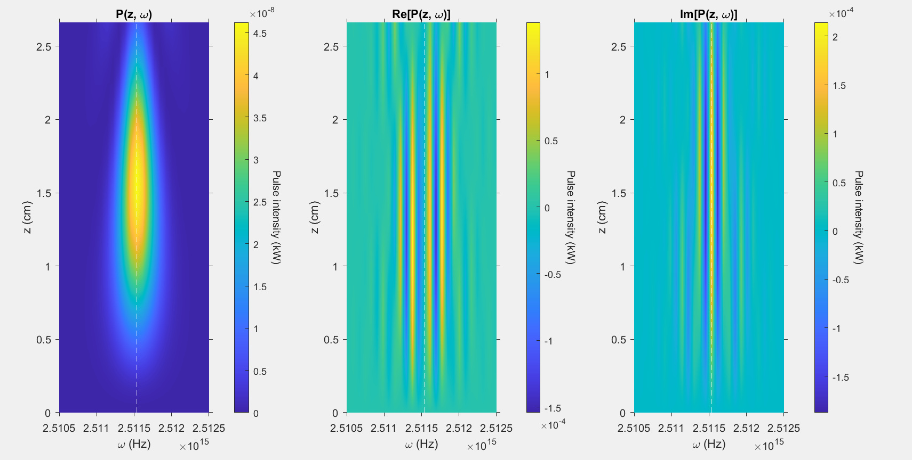

Slide 5
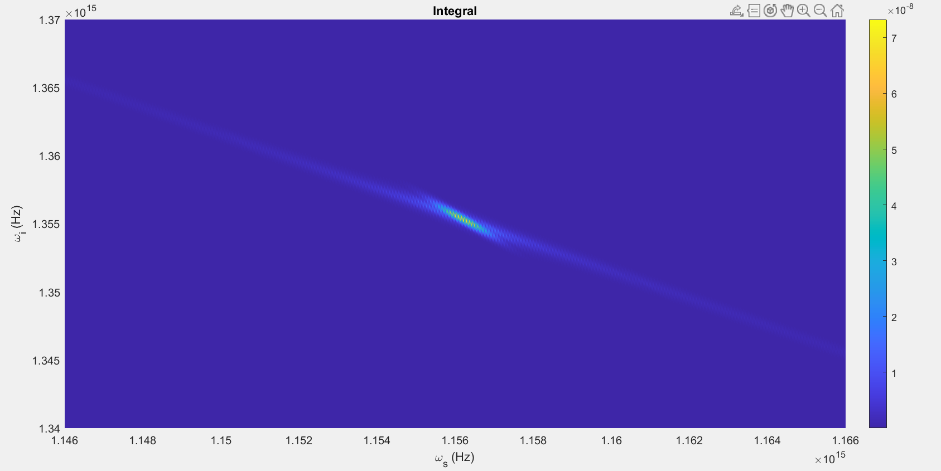

Slide 6
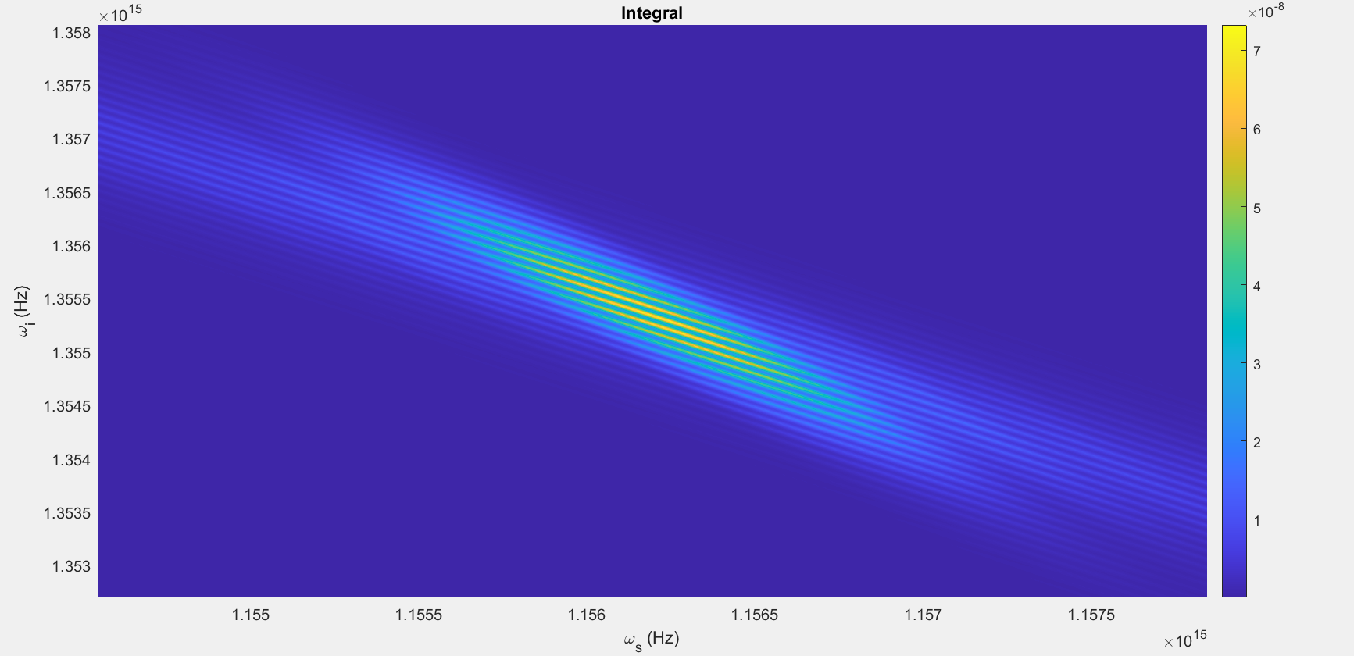

Slide 7
Parameters:
T = 80ps
Beta_f2 = 0.0083 ps^2/cm
Beta_s2 = 0.0022 ps^2/cm
Beta_p2 = 0.0253 ps^2/cm
Beta_f1 = 5.633 ps/cm
Beta_s1 = 5.333 ps/cm
Kappa = 6900, 1/cm
Gamma = 10^1.5, 1/(cm sqrt(kW))
C = 1, 1/cm
A = 1kW
Pulsewidth = 10ps
U0 = Complex

Slide 8
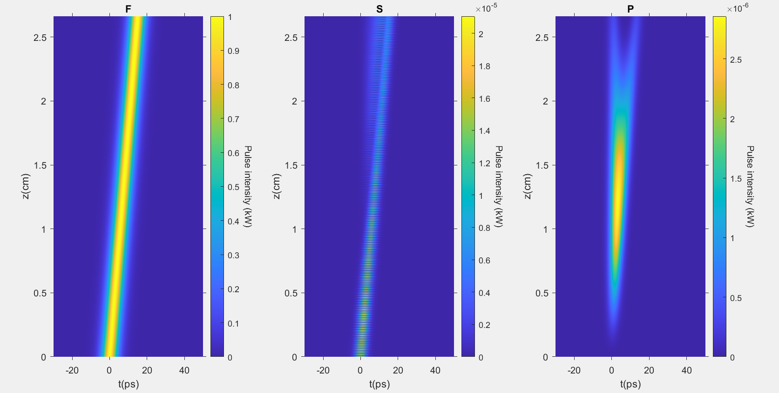

Slide 9
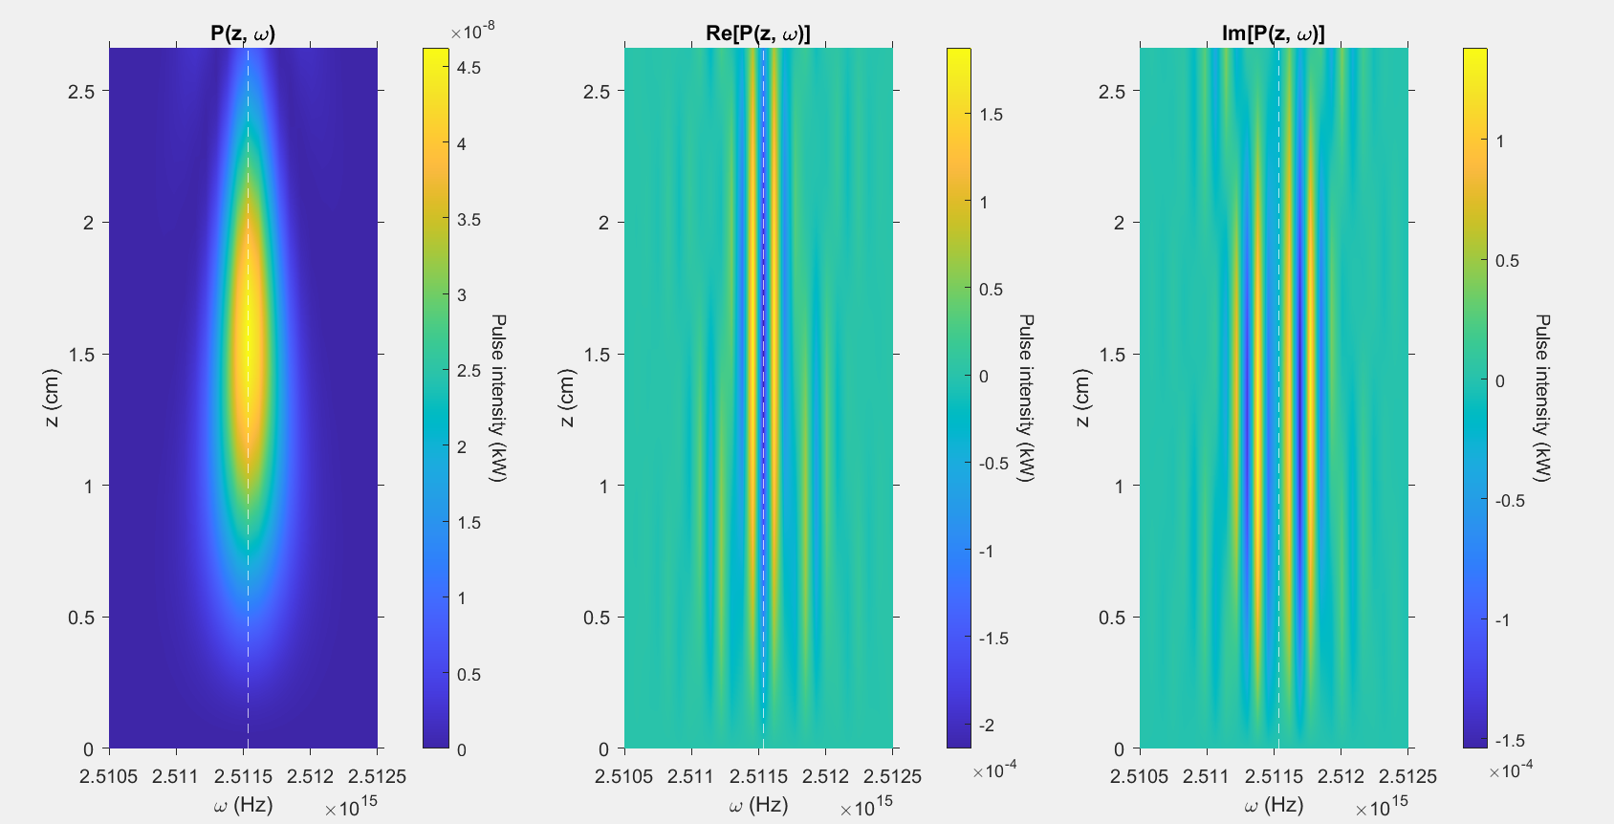

Slide 10
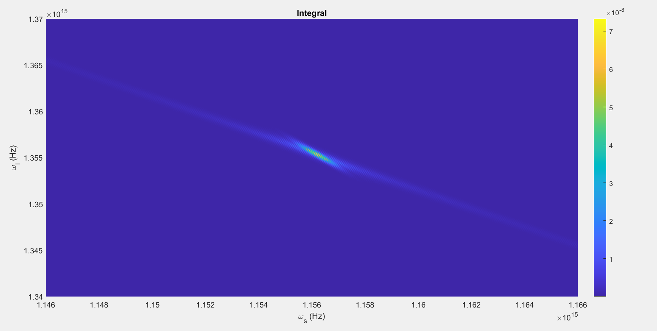

Slide 11
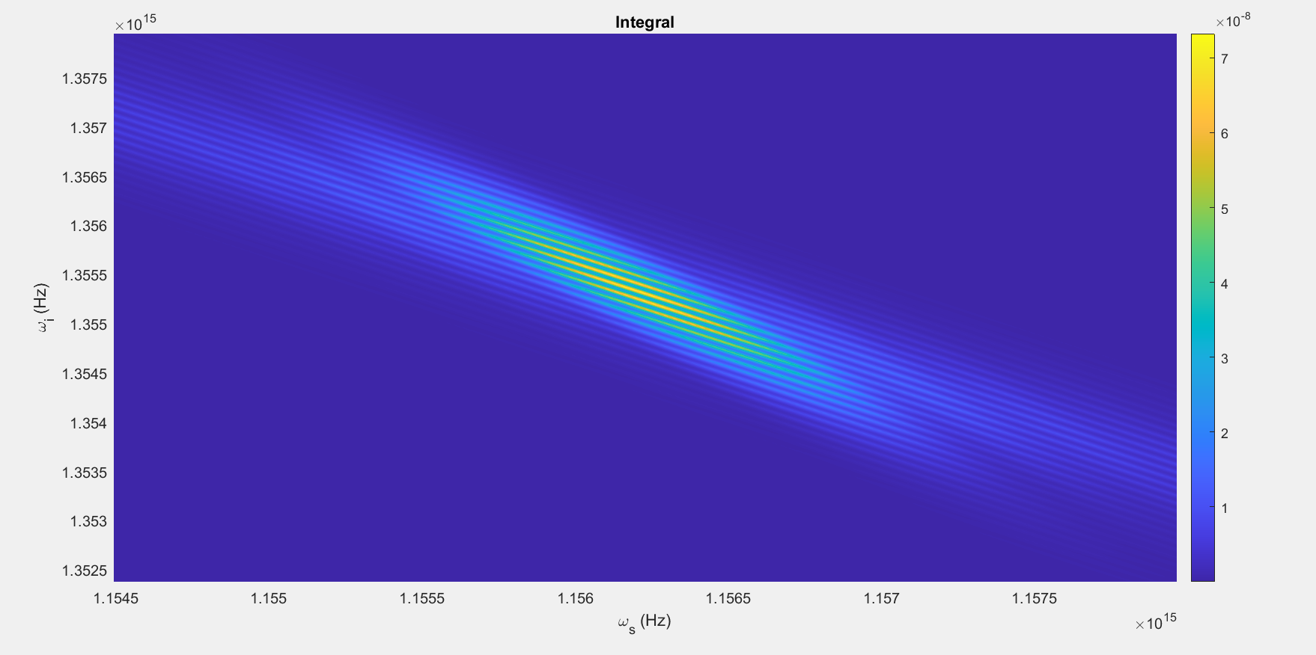

Slide 12
Parameters:
T = 80ps
Beta_f2 = 0.0083 ps^2/cm
Beta_s2 = 0.0022 ps^2/cm
Beta_p2 = 0.0253 ps^2/cm
Beta_f1 = 5.633 ps/cm
Beta_s1 = 5.333 ps/cm
Kappa = 6900, 1/cm
Gamma = 10^1.5, 1/(cm sqrt(kW))
C = 2, 1/cm
A = 1kW
Pulsewidth = 10ps
U0 = Real

Slide 13
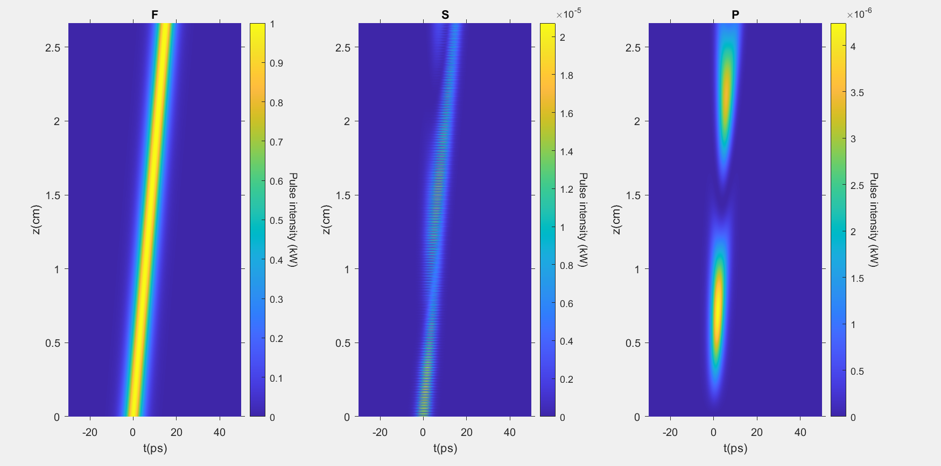

Slide 14
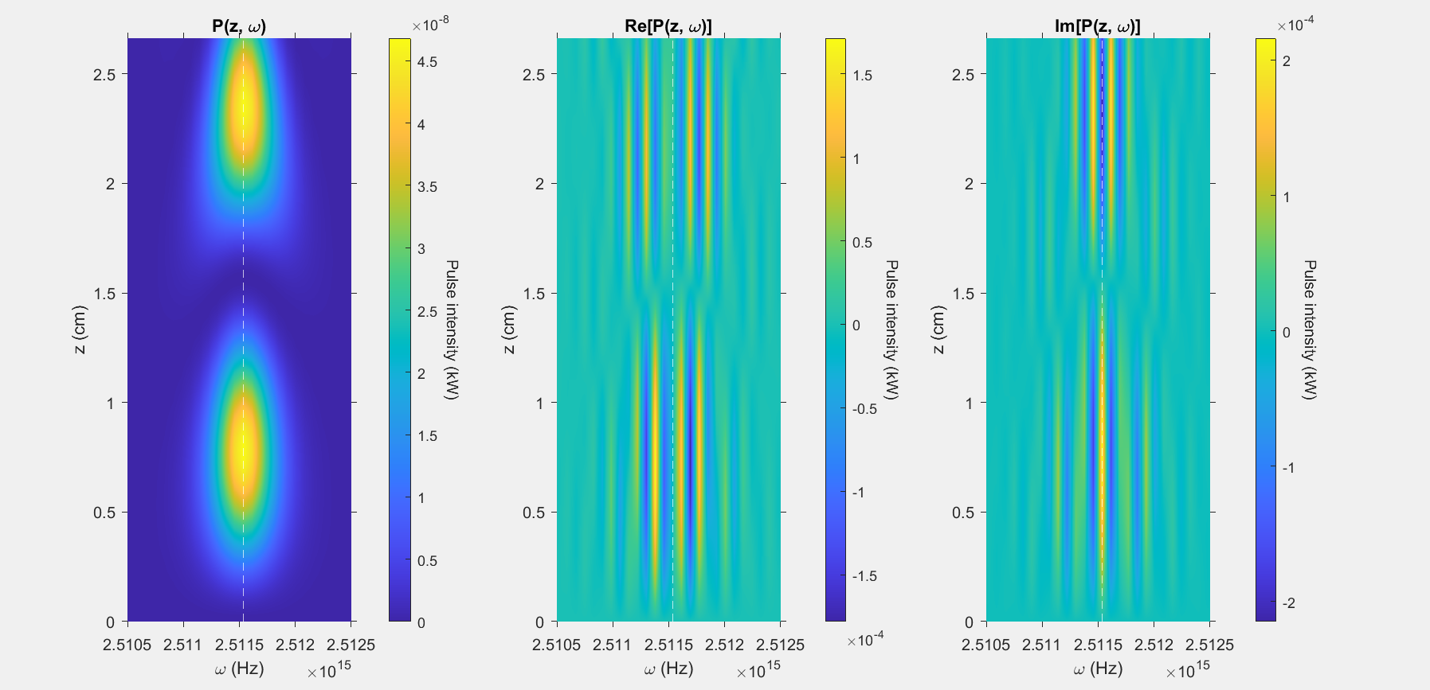

Slide 15
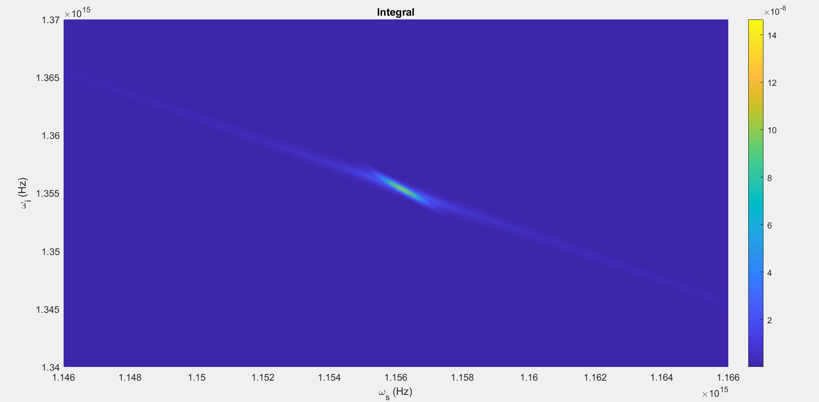

Slide 16
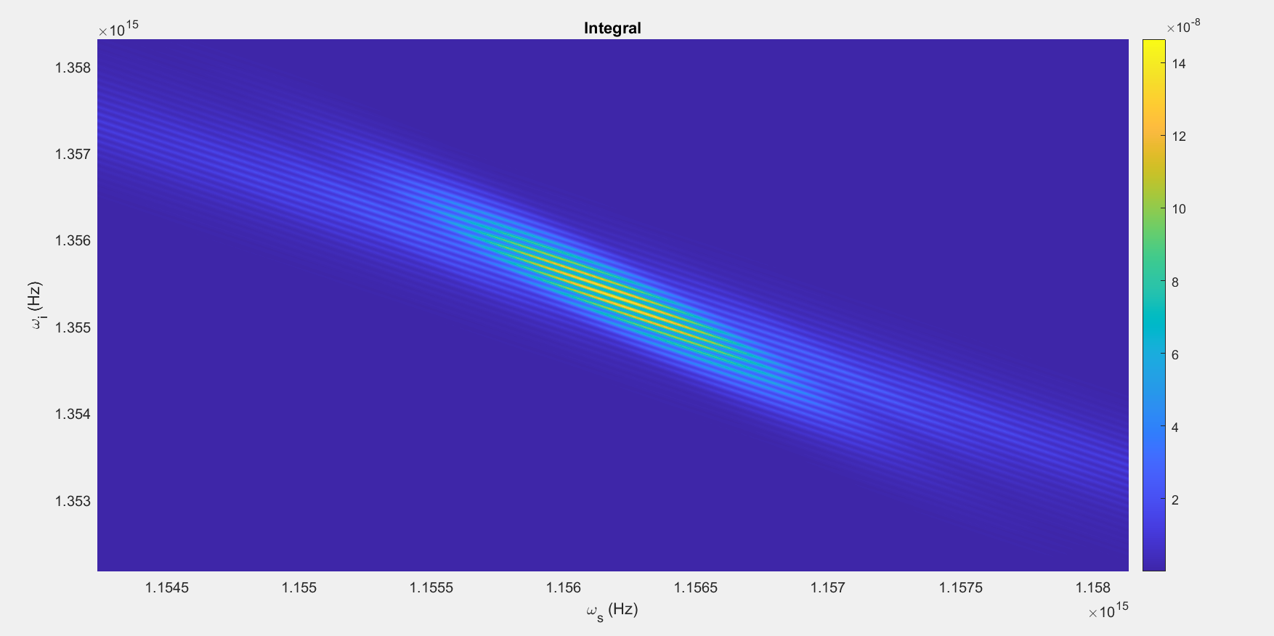

Slide 17
Parameters:
T = 80ps
Beta_f2 = 0.0083 ps^2/cm
Beta_s2 = 0.0022 ps^2/cm
Beta_p2 = 0.0253 ps^2/cm
Beta_f1 = 5.633 ps/cm
Beta_s1 = 5.333 ps/cm
Kappa = 6900, 1/cm
Gamma = 10^1.5, 1/(cm sqrt(kW))
C = 0.5, 1/cm
A = 1kW
Pulsewidth = 10ps
U0 = Real

Slide 18
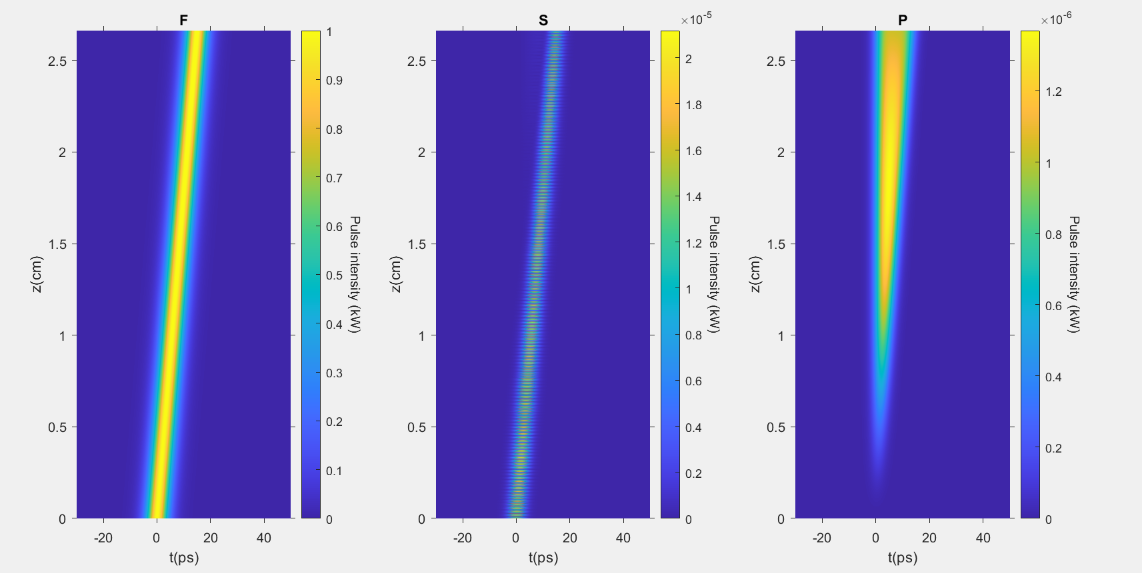

Slide 19
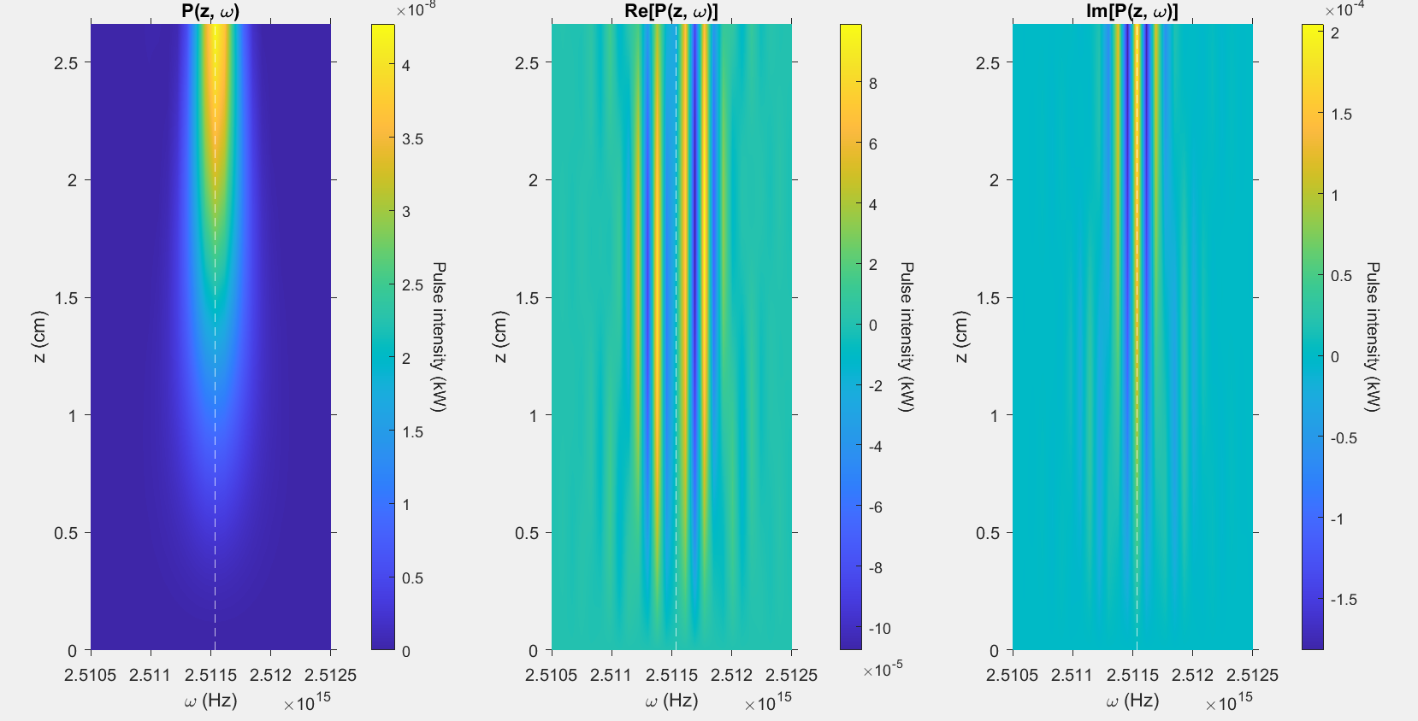

Slide 20
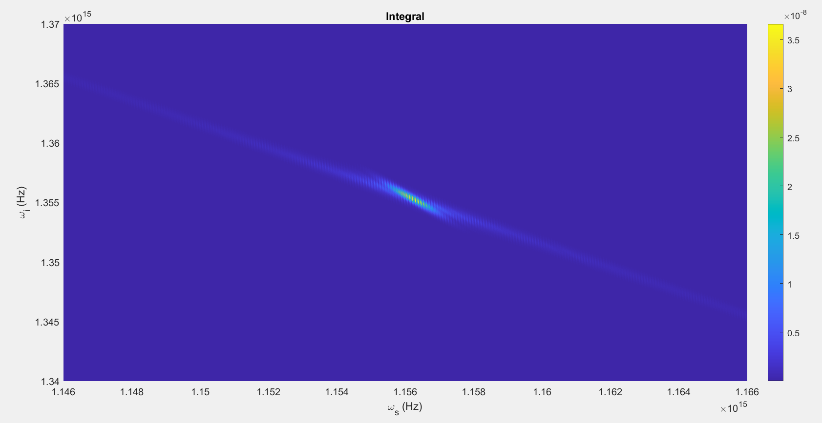

Slide 21
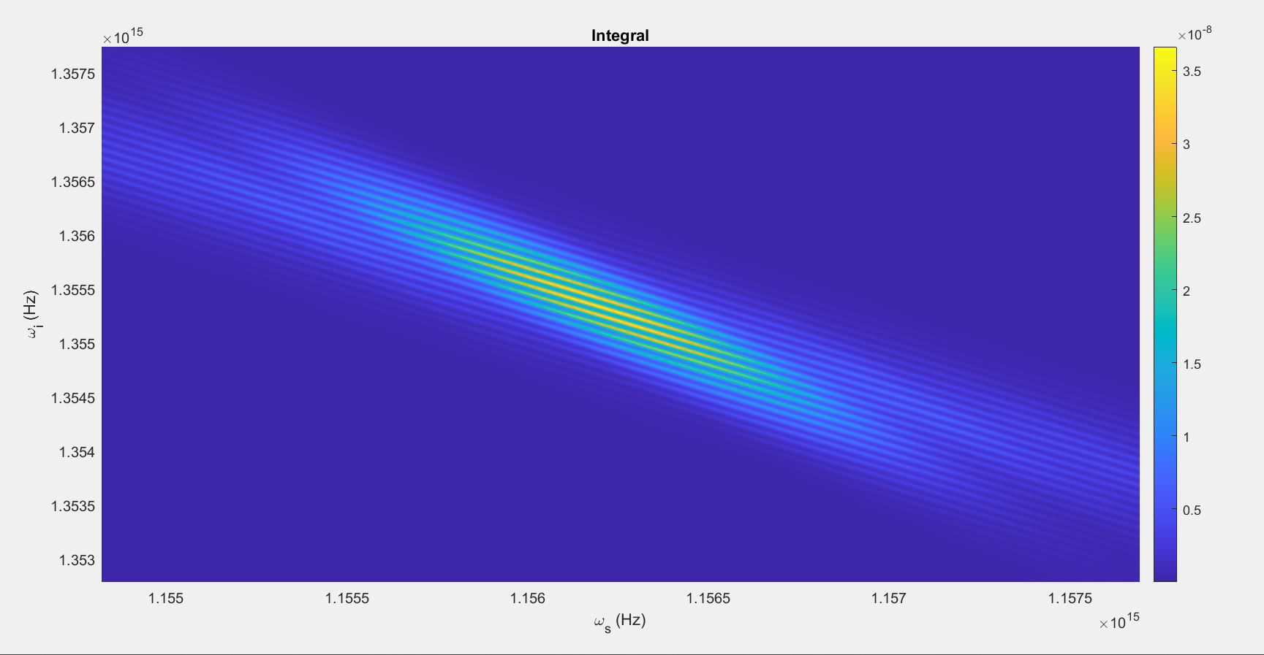

Slide 22
Parameters:
T = 80ps
Beta_f2 = 0.0083 ps^2/cm
Beta_s2 = 0.0022 ps^2/cm
Beta_p2 = 0.0253 ps^2/cm
Beta_f1 = 5.633 ps/cm
Beta_s1 = 5.333 ps/cm
Kappa = 13800, 1/cm
Gamma = 10^1.5, 1/(cm sqrt(kW))
C = 1, 1/cm
A = 1kW
Pulsewidth = 10ps
U0 = Real

Slide 23
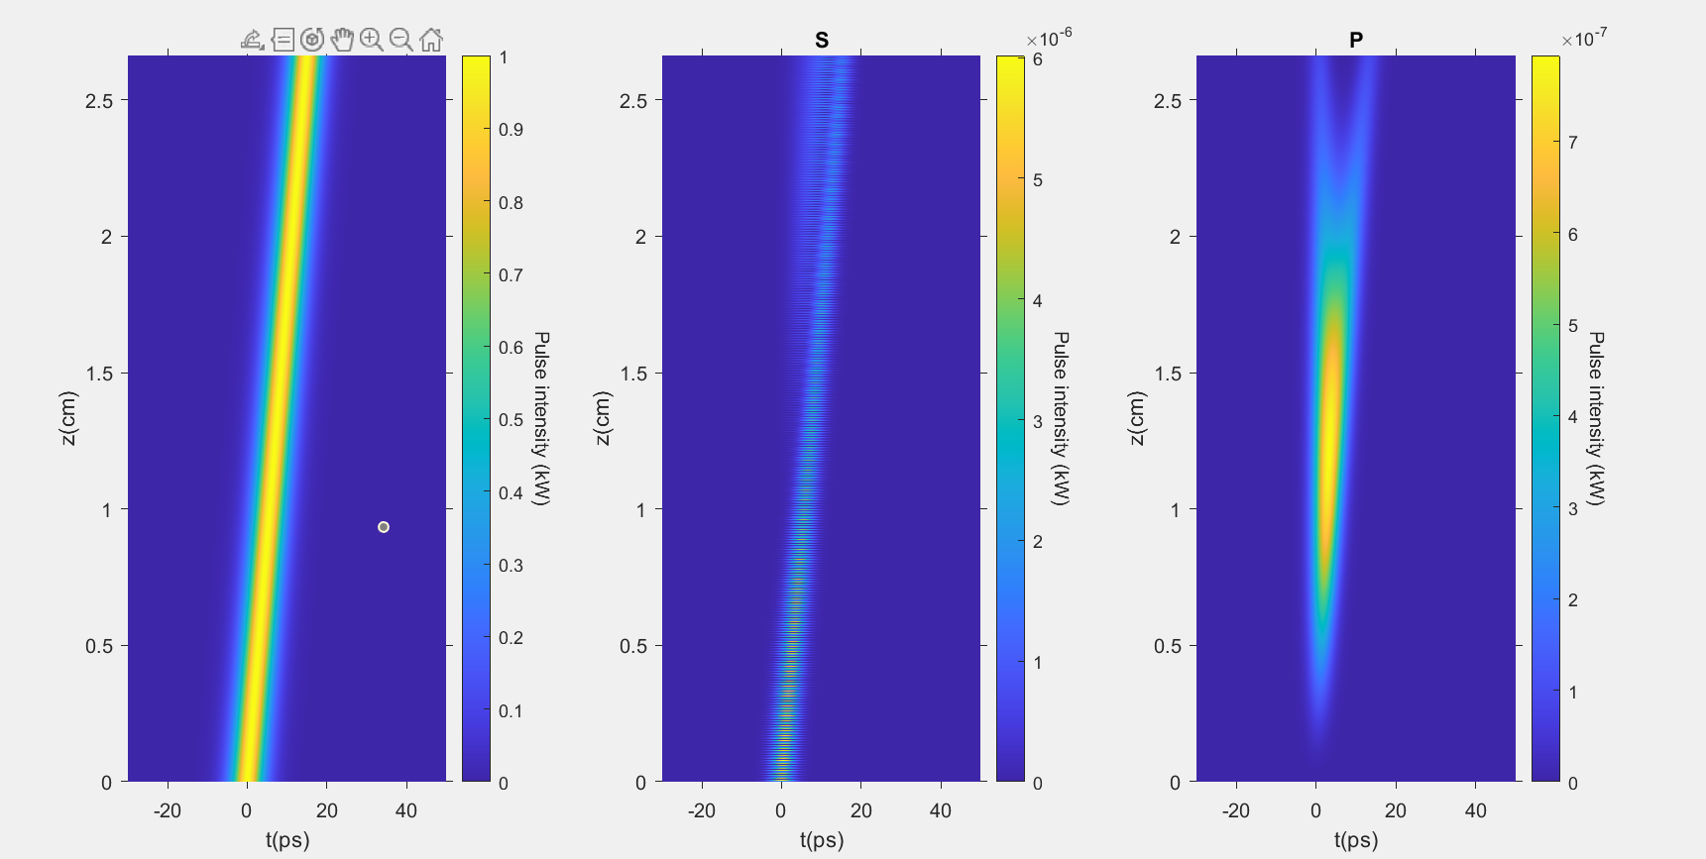

Slide 24
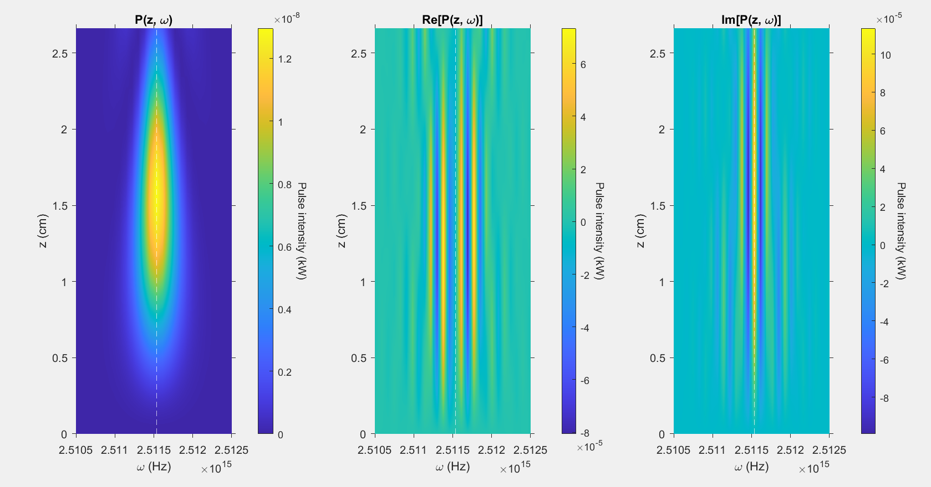

Slide 25
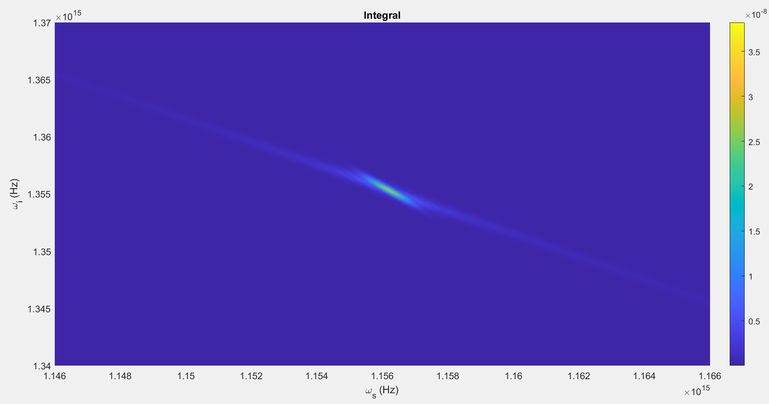

Slide 26
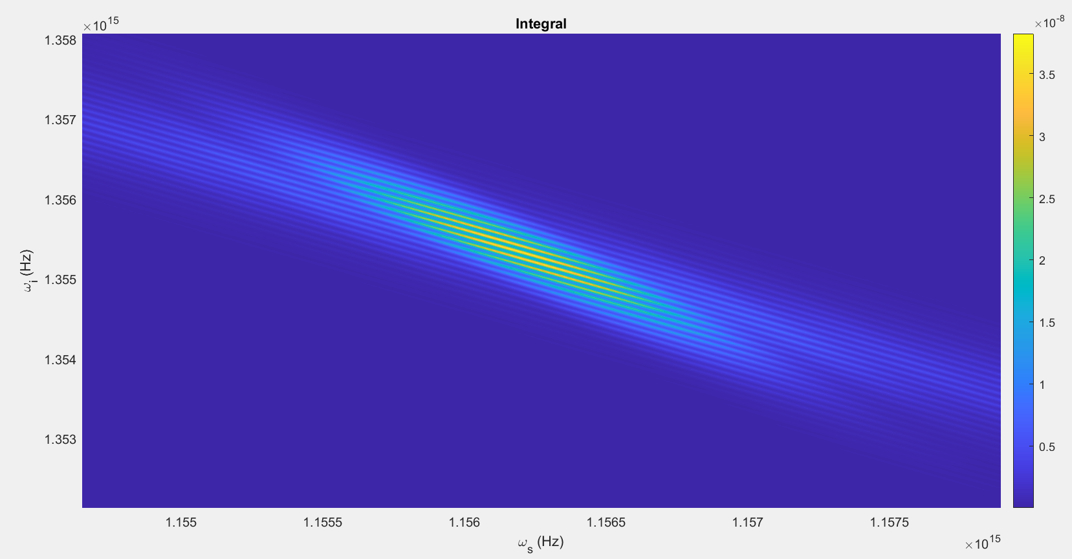

Slide 27
Parameters:
T = 80ps
Beta_f2 = 0.0083 ps^2/cm
Beta_s2 = 0.0022 ps^2/cm
Beta_p2 = 0.0253 ps^2/cm
Beta_f1 = 5.633 ps/cm
Beta_s1 = 5.333 ps/cm
Kappa = 3450, 1/cm
Gamma = 10^1.5, 1/(cm sqrt(kW))
C = 1, 1/cm
A = 1kW
Pulsewidth = 10ps
U0 = Real

Slide 28
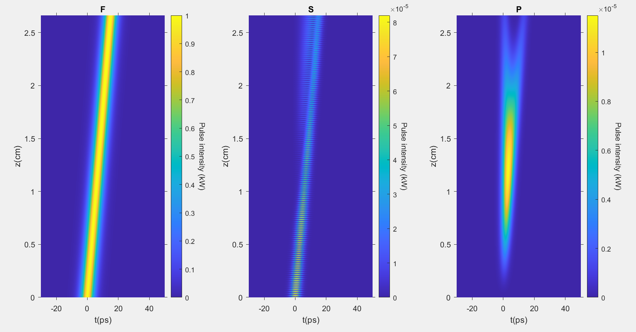

Slide 29
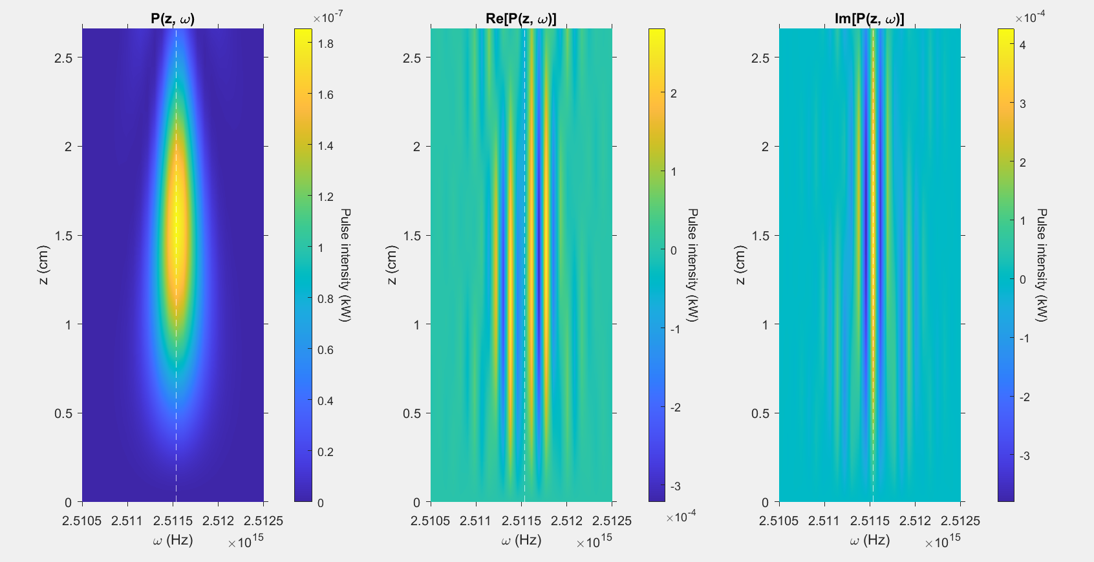

Slide 30
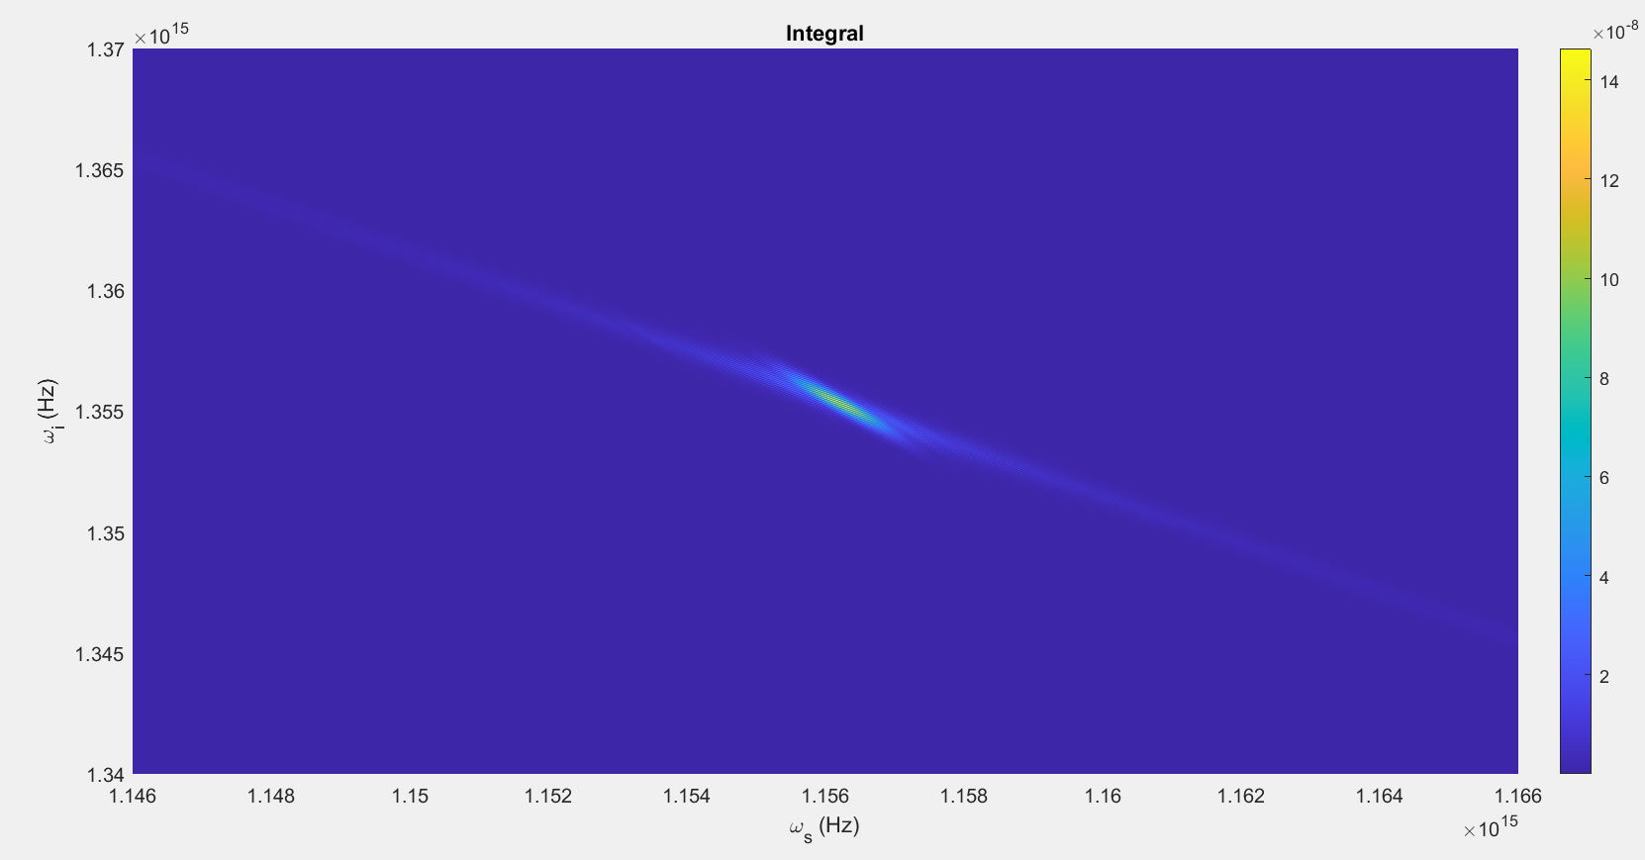

Slide 31
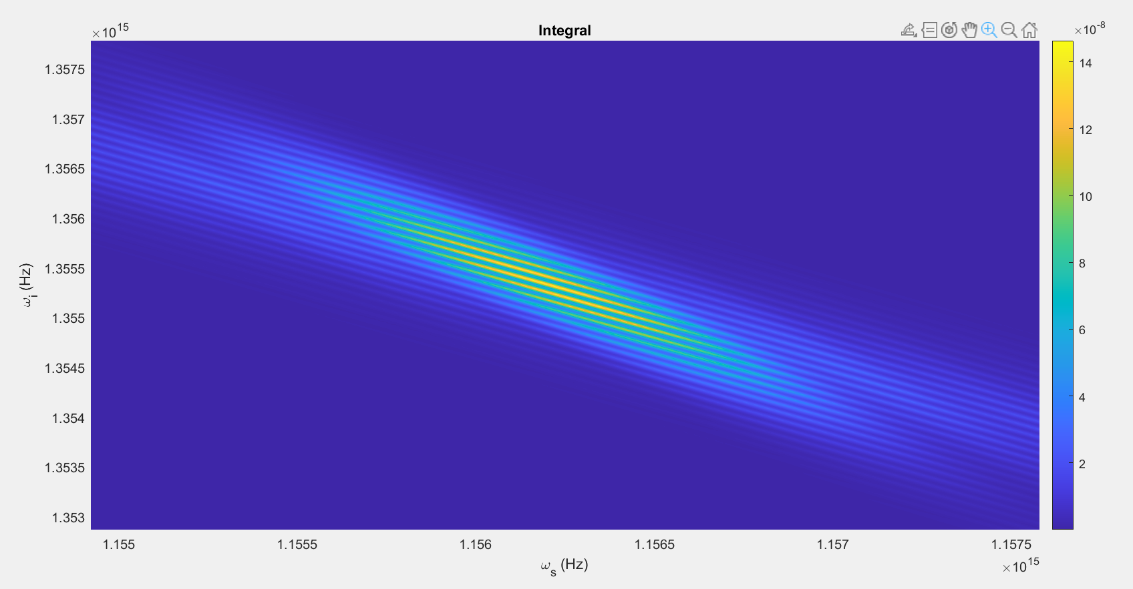

Slide 32
Parameters:
T = 80ps
Beta_f2 = 0.0083 ps^2/cm
Beta_s2 = 0.0022 ps^2/cm
Beta_p2 = 0.0253 ps^2/cm
Beta_f1 = 5.633 ps/cm
Beta_s1 = 5.333 ps/cm
Kappa = 6900, 1/cm
Gamma = 2*10^1.5, 1/(cm sqrt(kW))
C = 1, 1/cm
A = 1kW
Pulsewidth = 10ps
U0 = Real

Slide 33
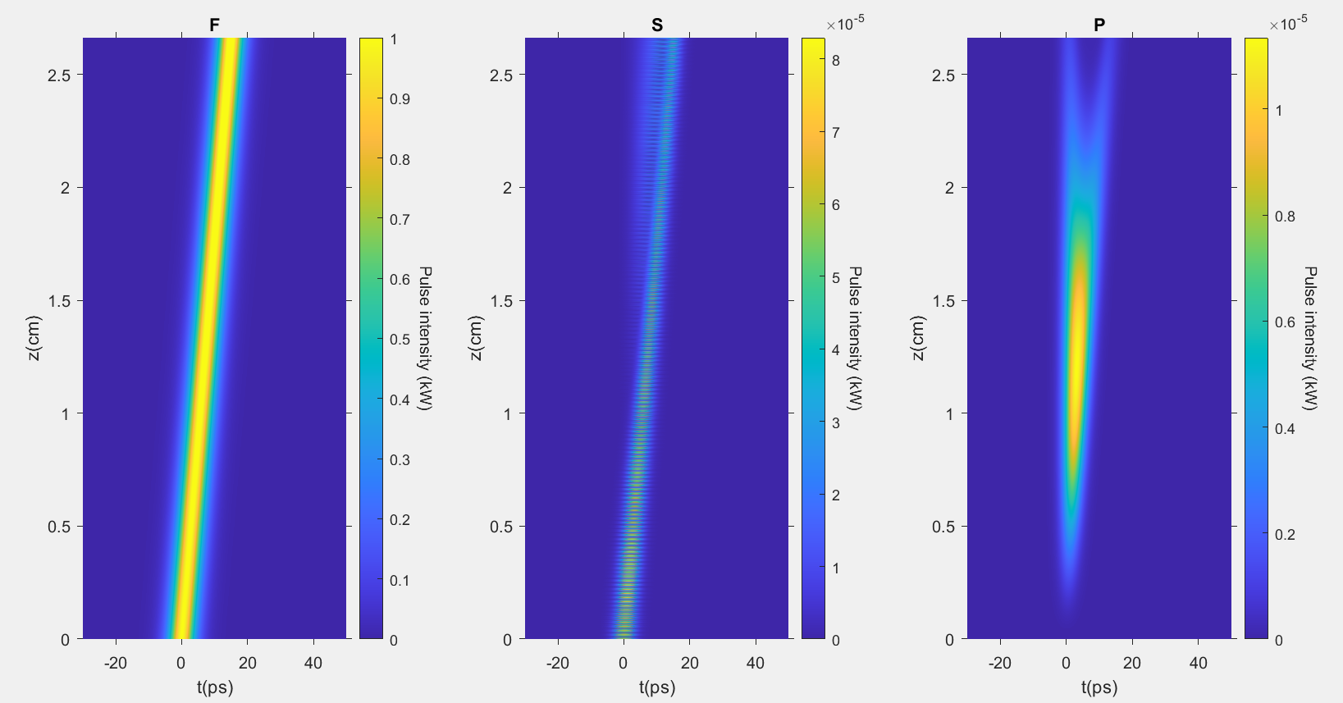

Slide 34
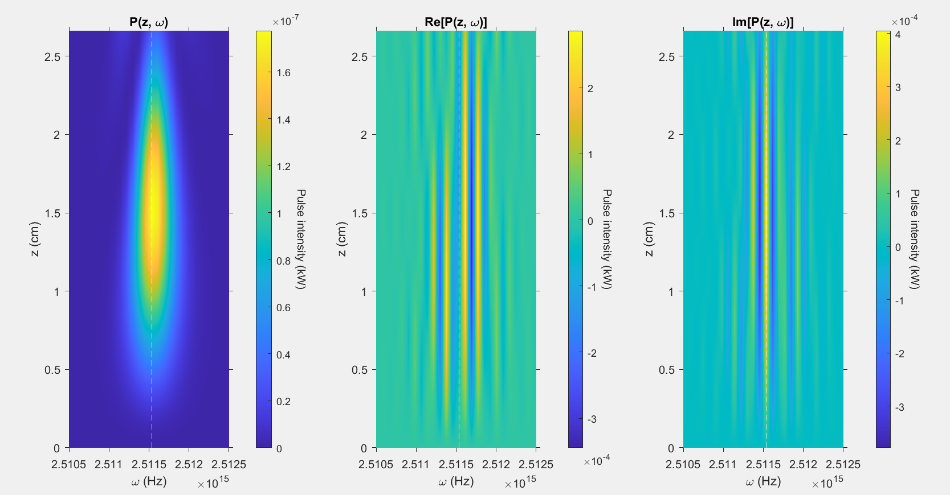

Slide 35
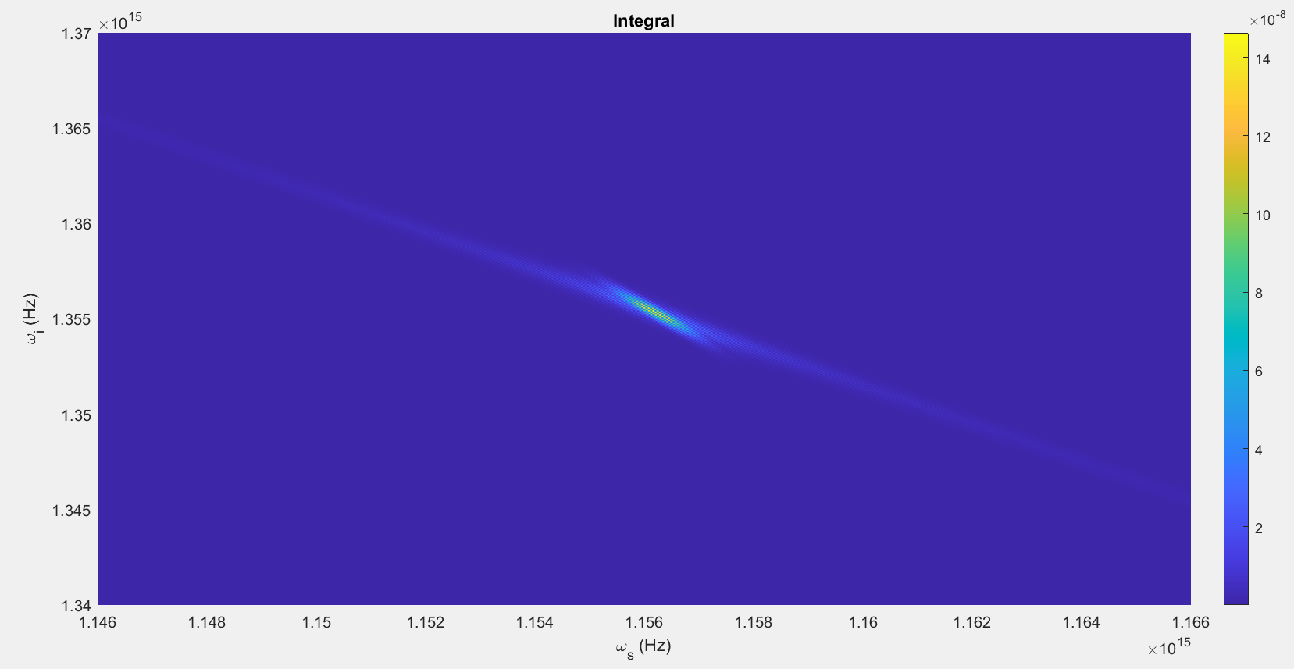

Slide 36
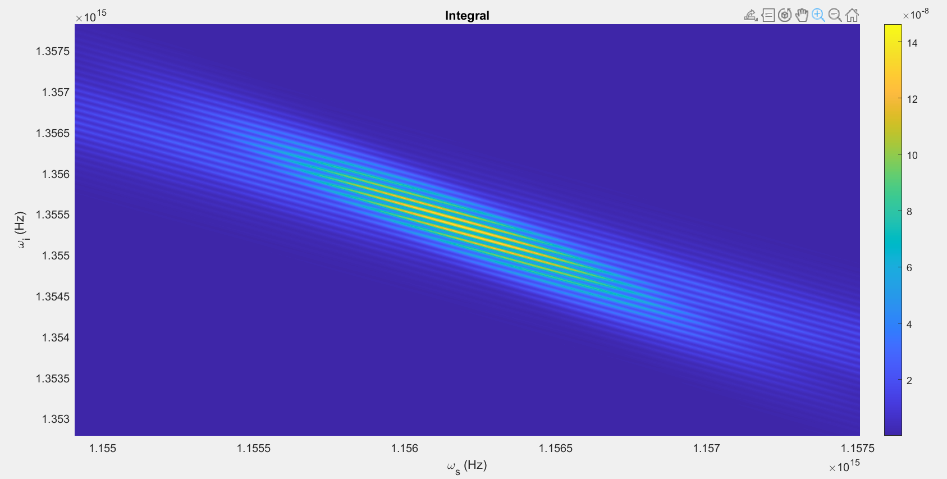

Slide 37
Parameters:
T = 80ps
Beta_f2 = 0.0083 ps^2/cm
Beta_s2 = 0.0022 ps^2/cm
Beta_p2 = 0.0253 ps^2/cm
Beta_f1 = 5.633 ps/cm
Beta_s1 = 5.333 ps/cm
Kappa = 6900, 1/cm
Gamma = 0.5*10^1.5, 1/(cm sqrt(kW))
C = 1, 1/cm
A = 1kW
Pulsewidth = 10ps
U0 = Real

Slide 38
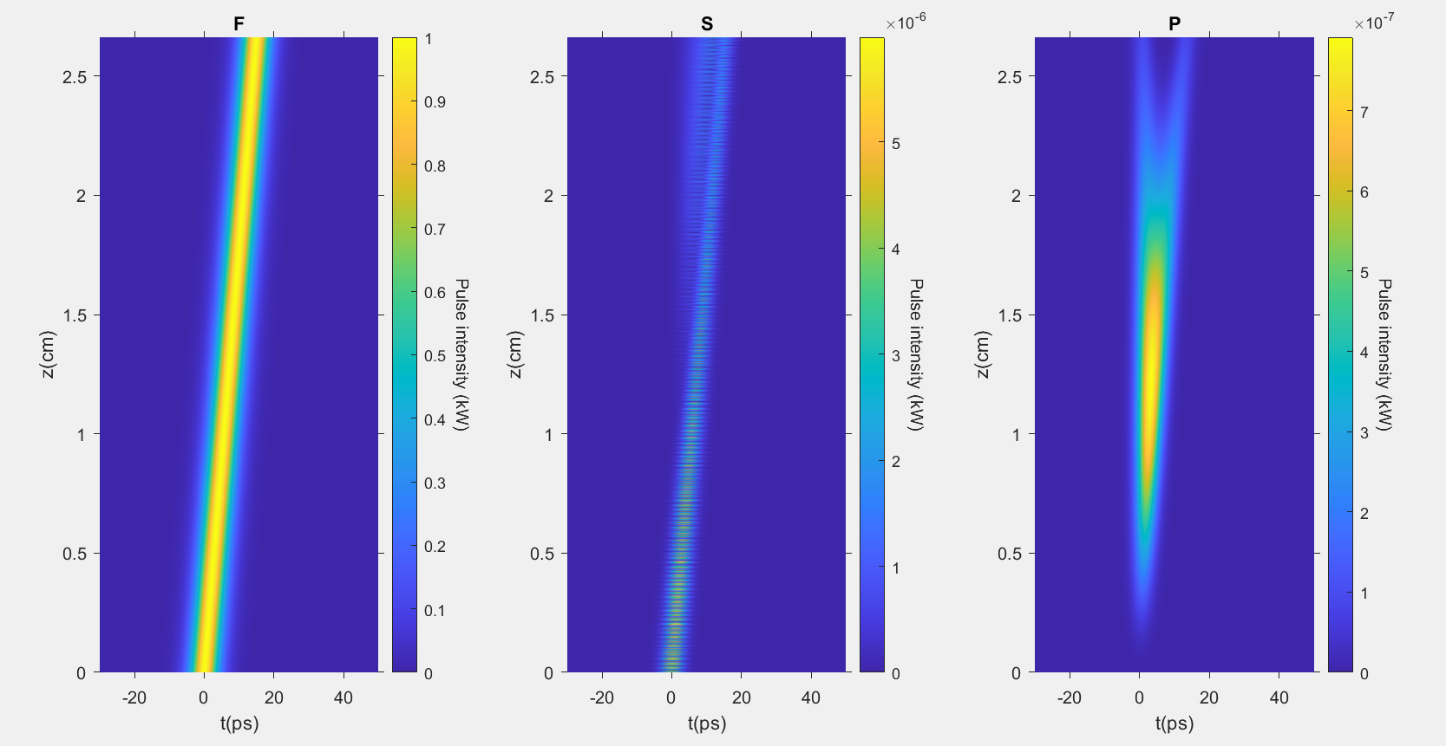

Slide 39
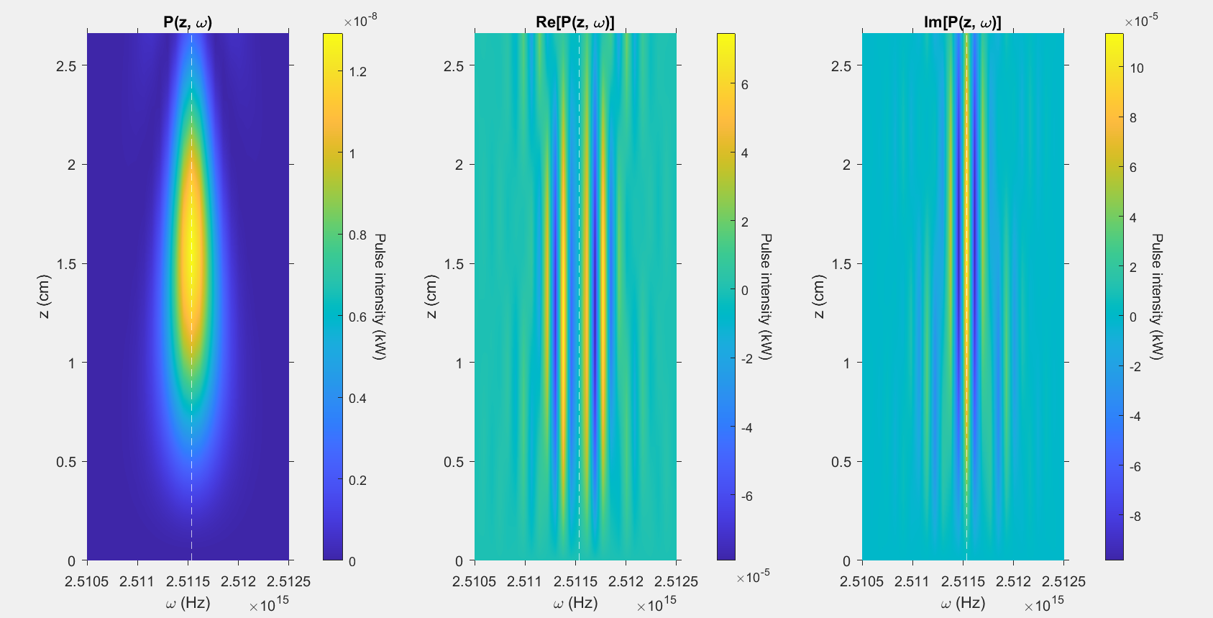

Slide 40
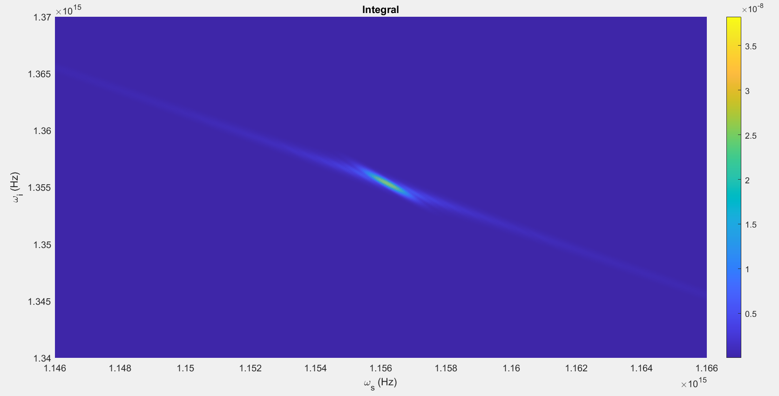

Slide 41
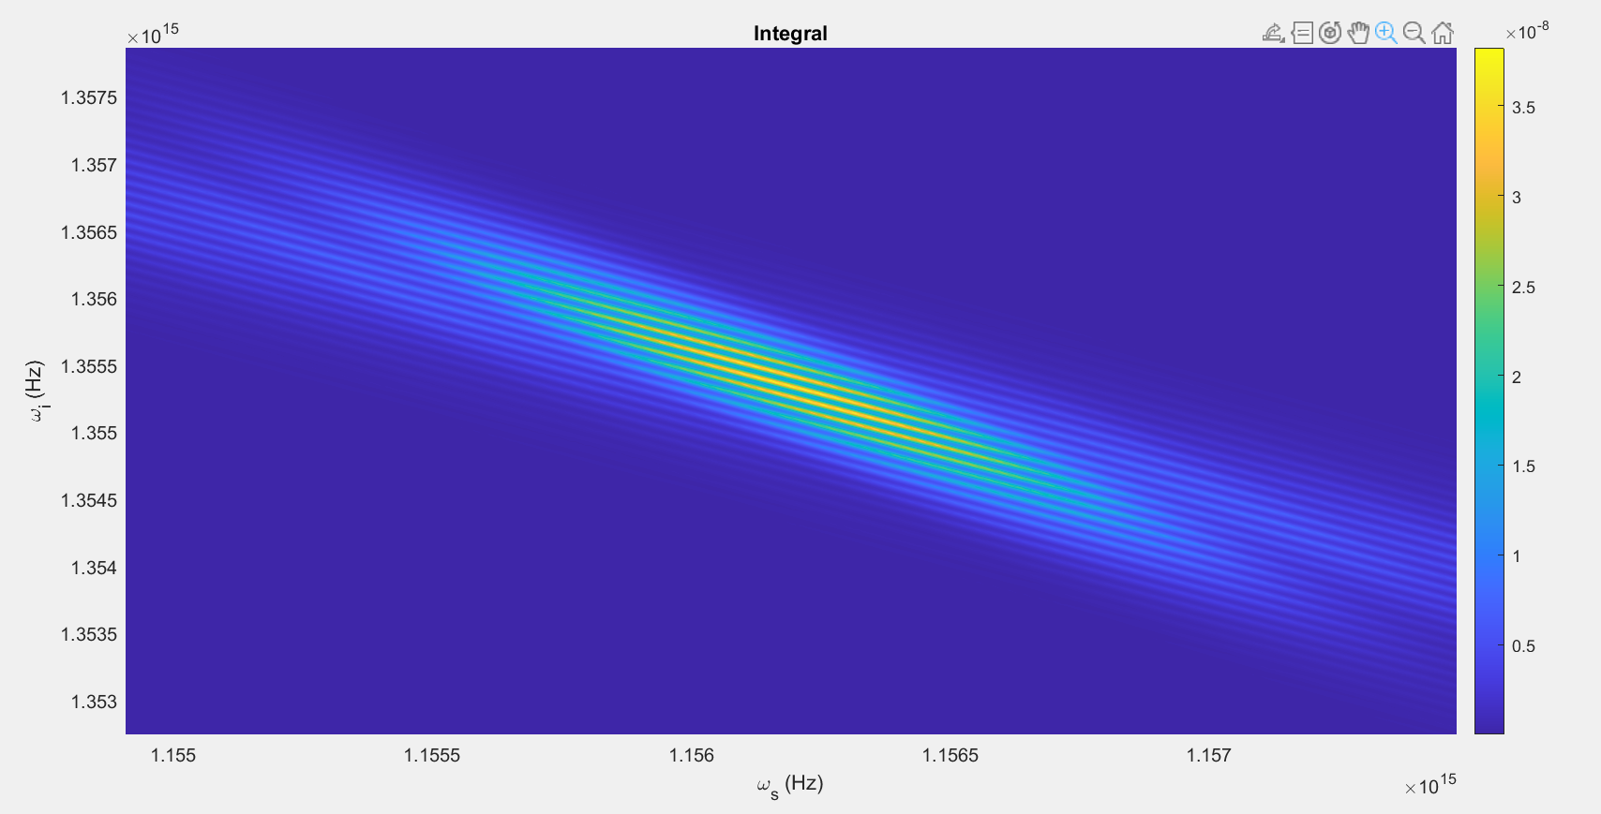

Slide 42
Parameters:
T = 80ps
Beta_f2 = 0.0083 ps^2/cm
Beta_s2 = 0.0022 ps^2/cm
Beta_p2 = 0.0253 ps^2/cm
Beta_f1 = 5.633 ps/cm
Beta_s1 = 5.333 ps/cm
Kappa = 6900, 1/cm
Gamma = 10^1.5, 1/(cm sqrt(kW))
C = 1, 1/cm
A = 2kW
Pulsewidth = 10ps
U0 = Real

Slide 43
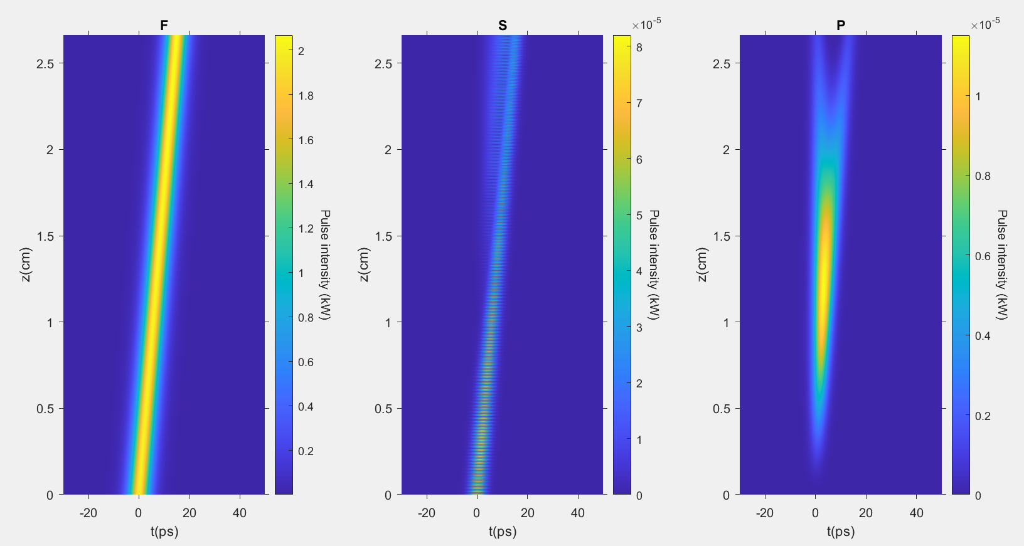

Slide 44
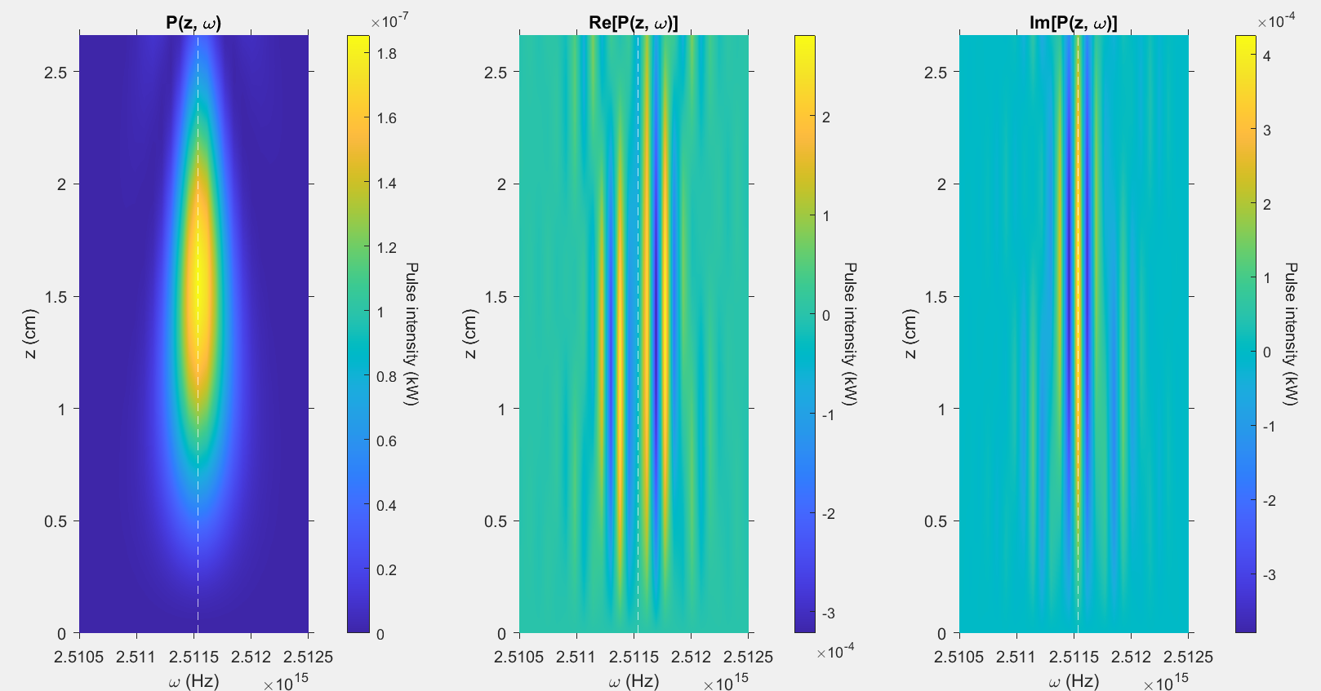

Slide 45
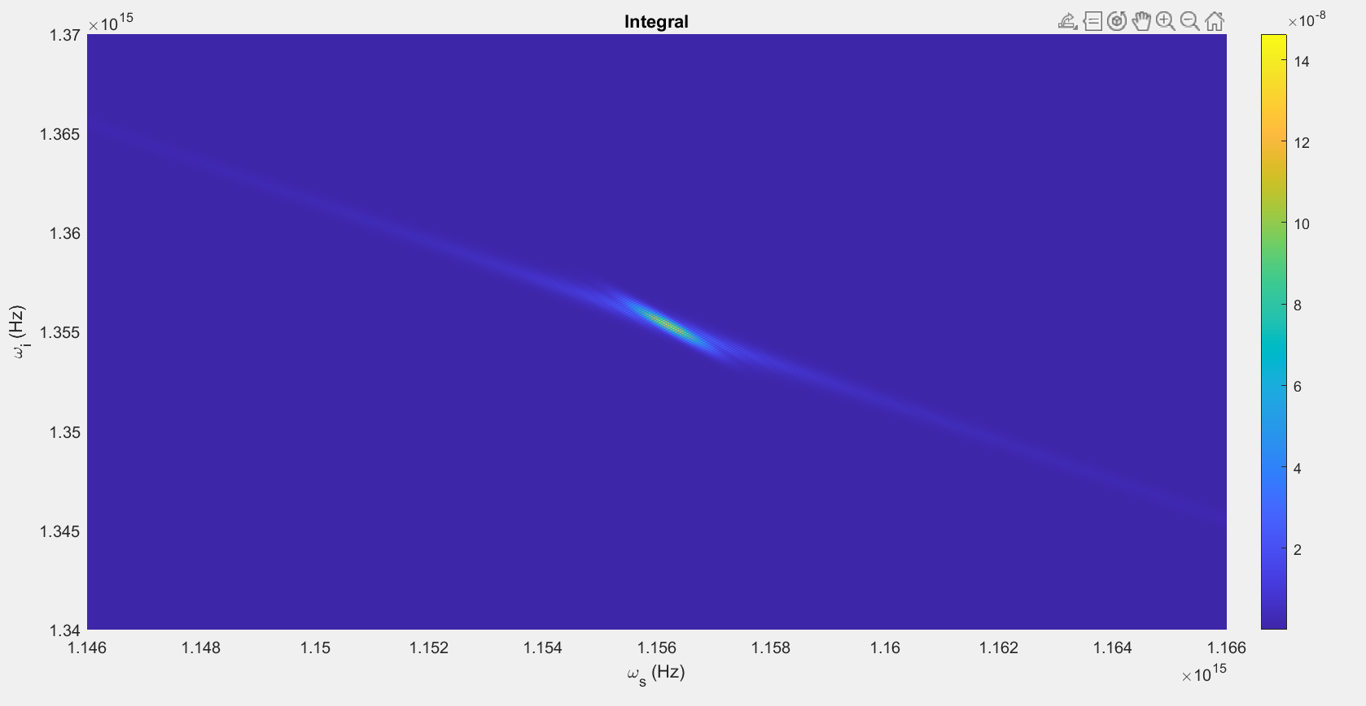

Slide 46
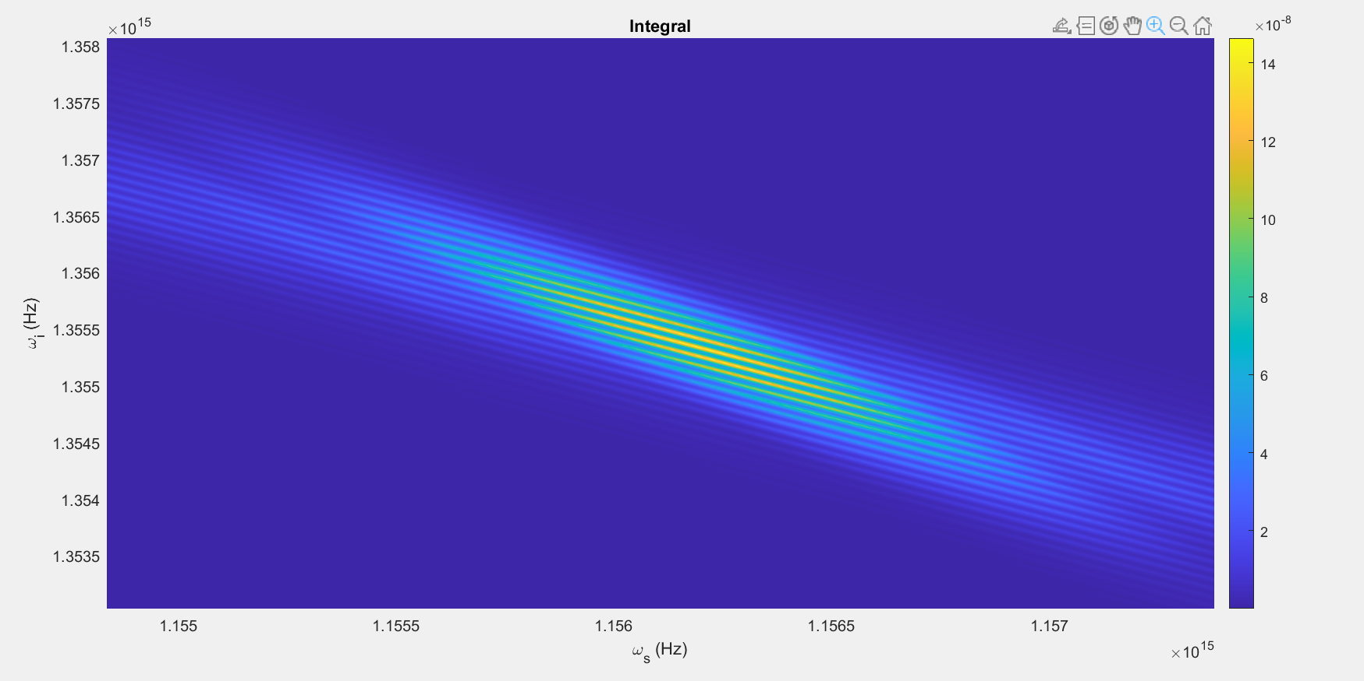

Slide 47
Parameters:
T = 80ps
Beta_f2 = 0.0083 ps^2/cm
Beta_s2 = 0.0022 ps^2/cm
Beta_p2 = 0.0253 ps^2/cm
Beta_f1 = 5.633 ps/cm
Beta_s1 = 5.333 ps/cm
Kappa = 6900, 1/cm
Gamma = 10^1.5, 1/(cm sqrt(kW))
C = 1, 1/cm
A = 0.5kW
Pulsewidth = 10ps
U0 = Real

Slide 48
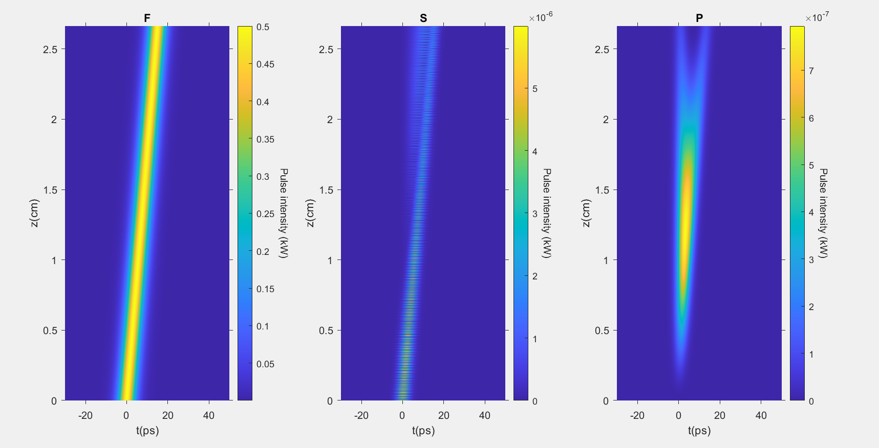

Slide 49
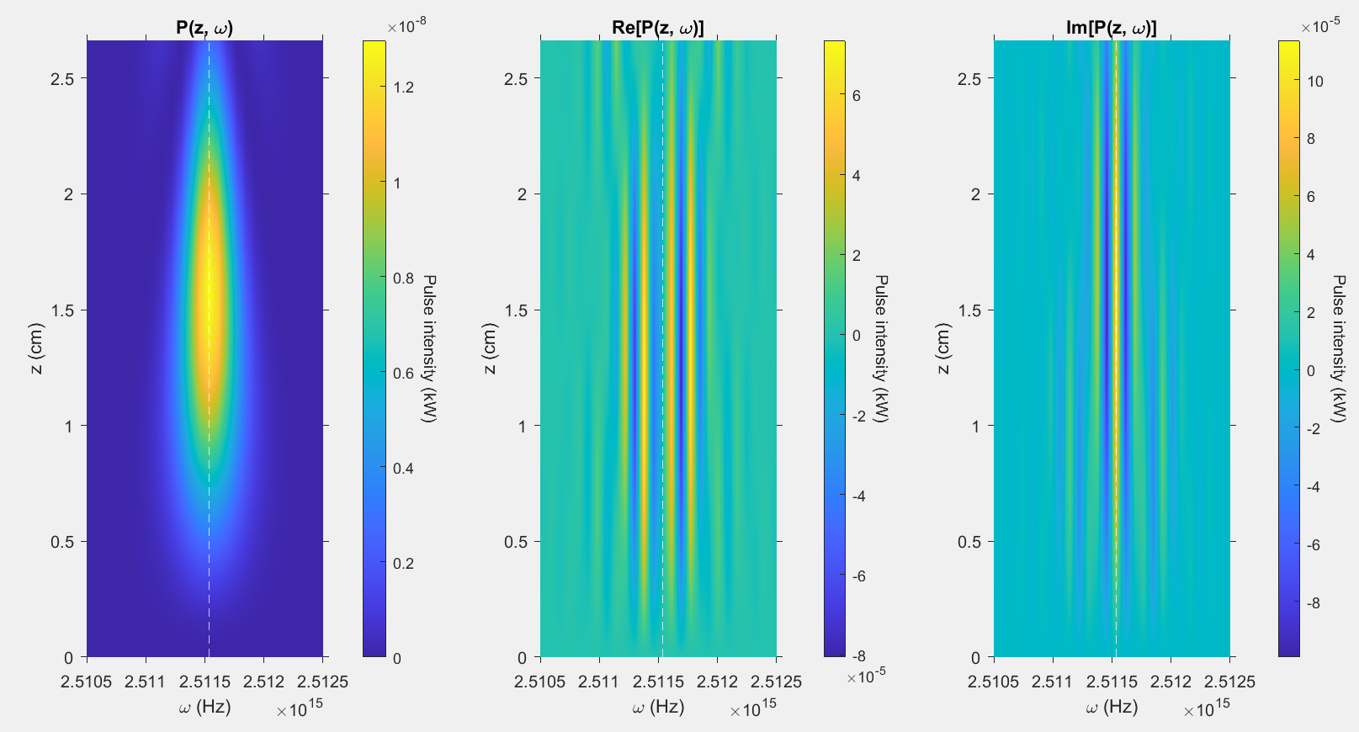

Slide 50
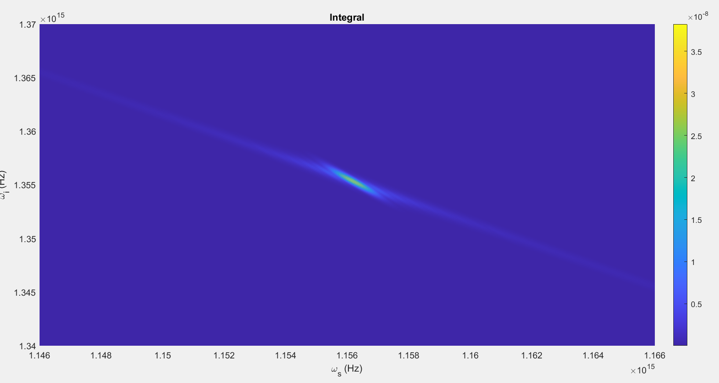

Slide 51
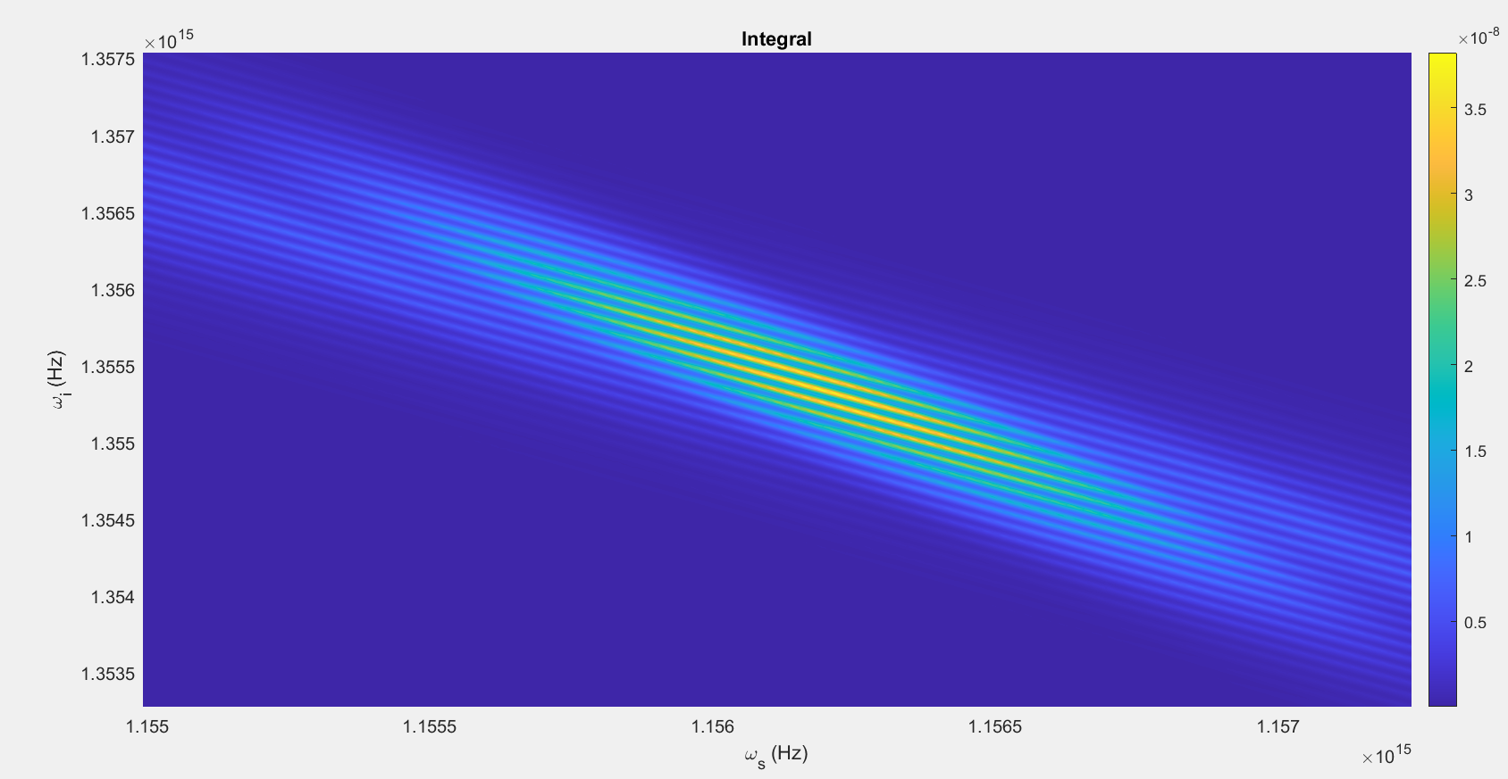

Slide 52
Parameters:
T = 80ps
Beta_f2 = 0.0083 ps^2/cm
Beta_s2 = 0.0022 ps^2/cm
Beta_p2 = 0.0253 ps^2/cm
Beta_f1 = 5.633 ps/cm
Beta_s1 = 5.333 ps/cm
Kappa = 6900, 1/cm
Gamma = 10^1.5, 1/(cm sqrt(kW))
C = 1, 1/cm
A = 1kW
Pulsewidth = 20ps
U0 = Real

Slide 53
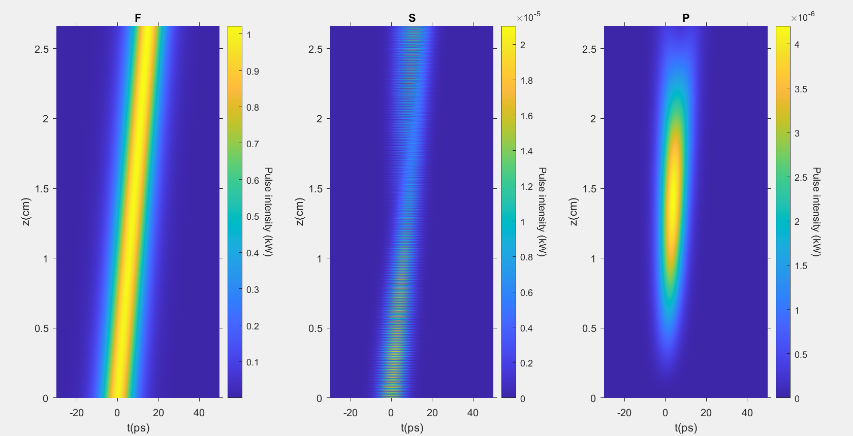

Slide 54
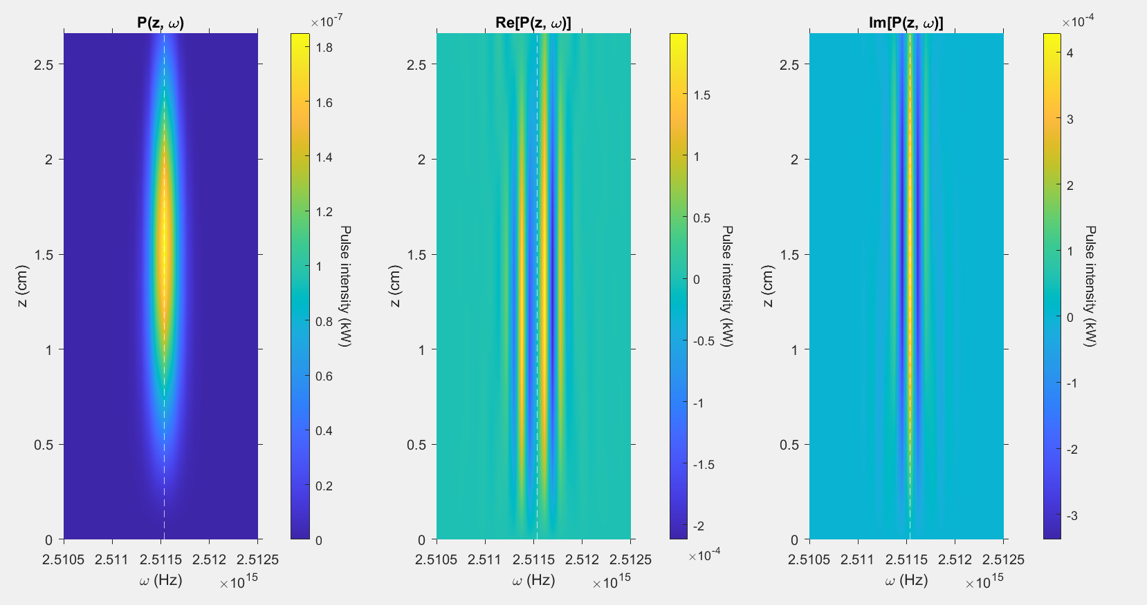

Slide 55
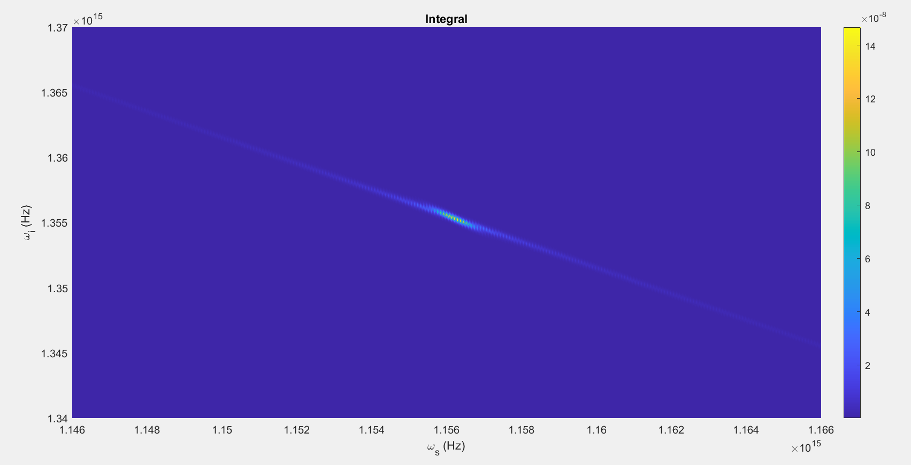

Slide 56
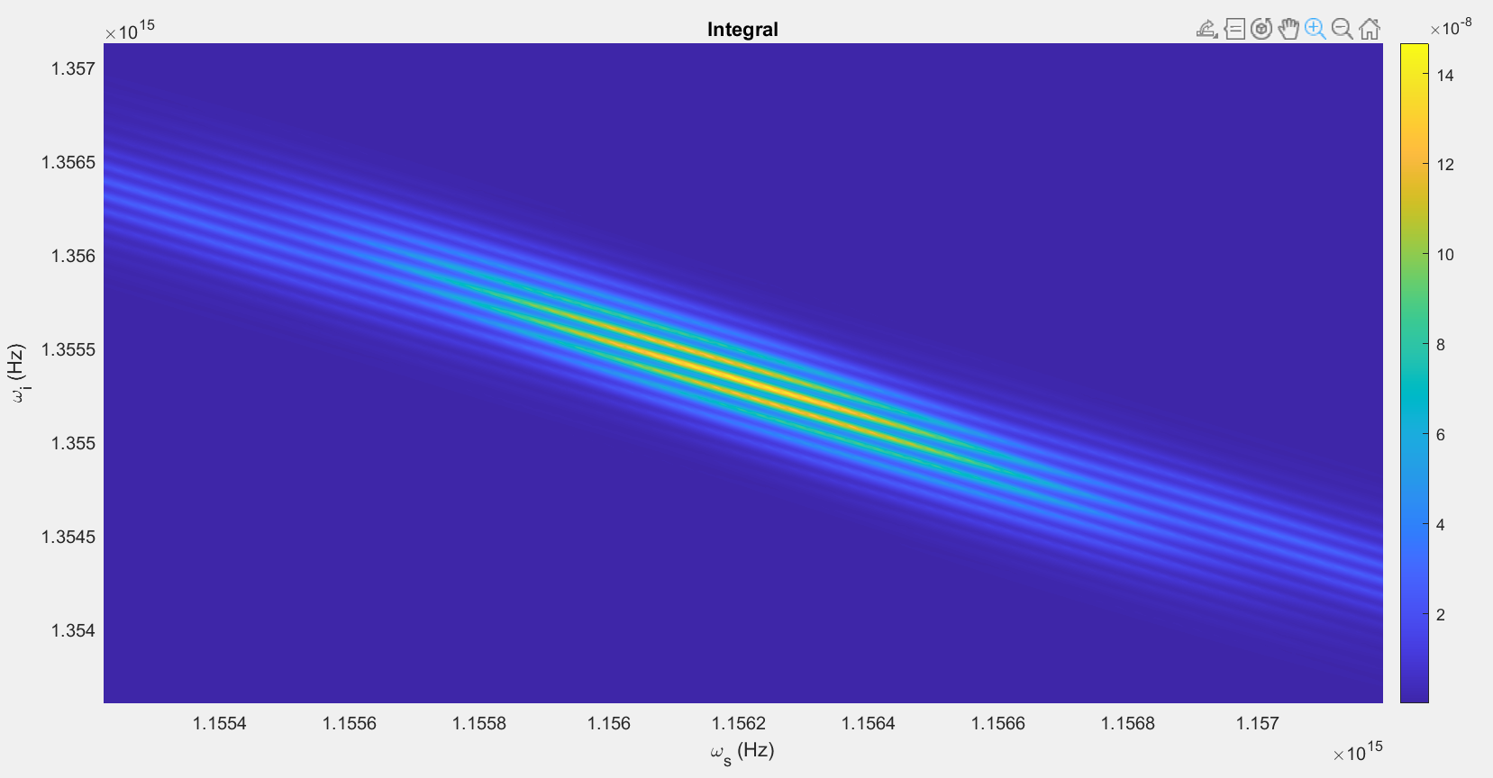

Slide 57
Parameters:
T = 80ps
Beta_f2 = 0.0083 ps^2/cm
Beta_s2 = 0.0022 ps^2/cm
Beta_p2 = 0.0253 ps^2/cm
Beta_f1 = 5.633 ps/cm
Beta_s1 = 5.333 ps/cm
Kappa = 6900, 1/cm
Gamma = 10^1.5, 1/(cm sqrt(kW))
C = 1, 1/cm
A = 1kW
Pulsewidth = 5ps
U0 = Real

Slide 58
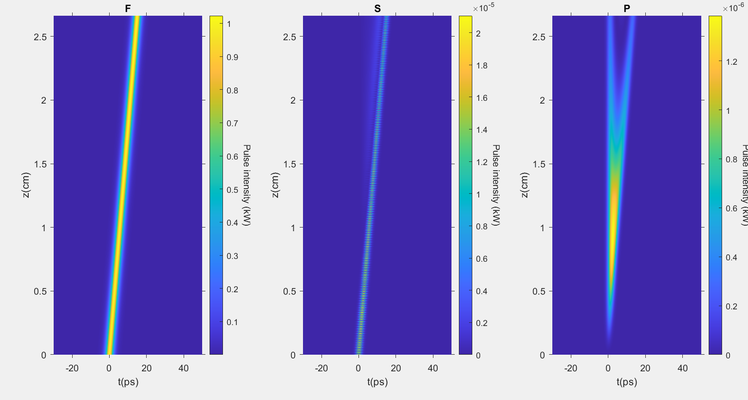

Slide 59
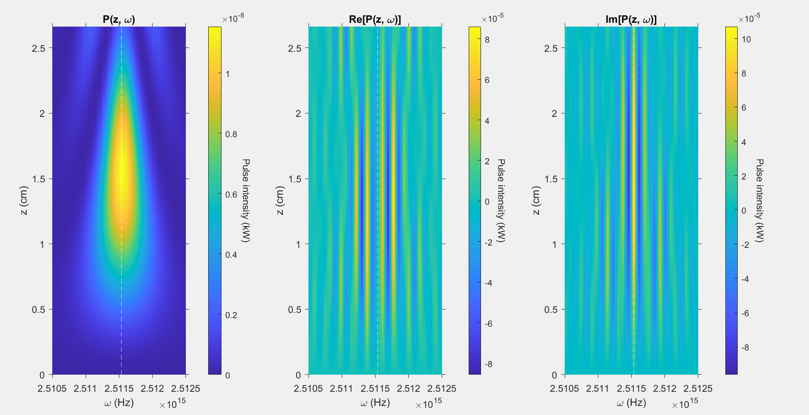

Slide 60
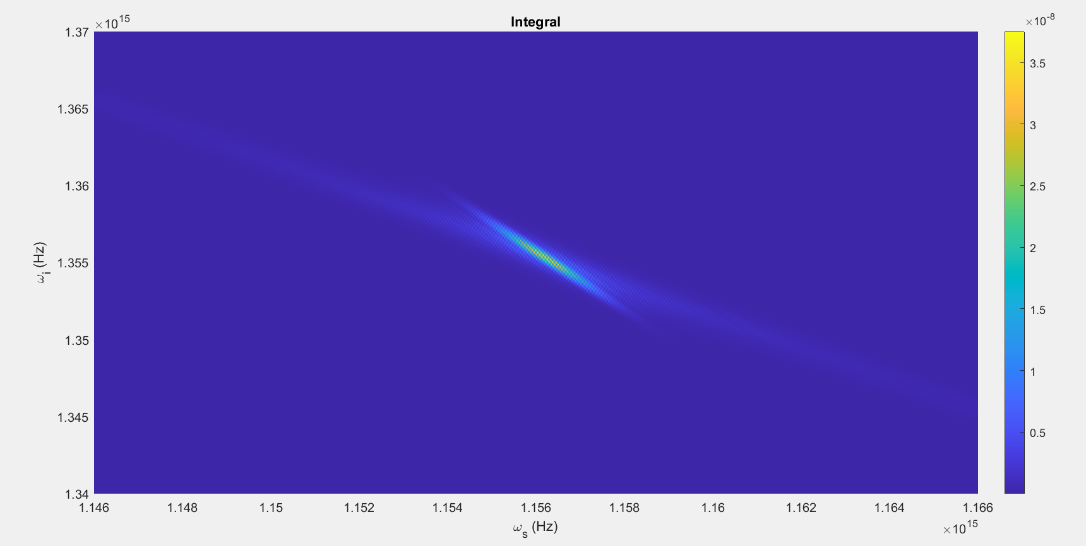

Slide 61
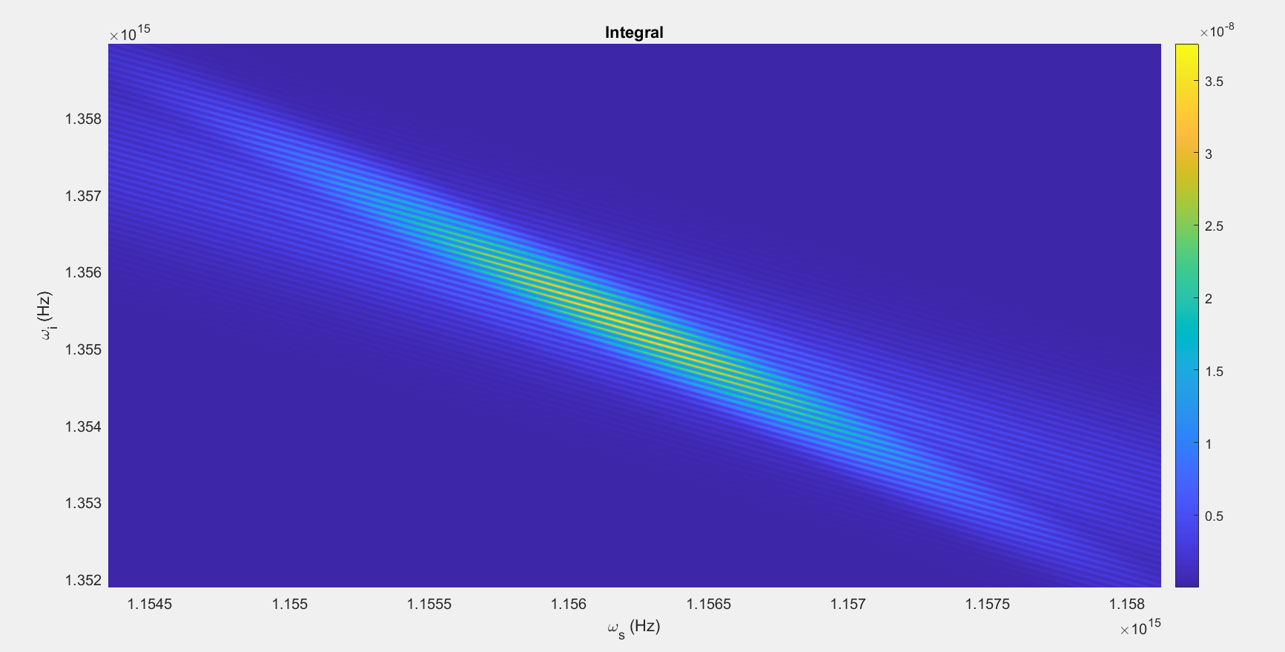

Slide 62
Parameters:
T = 160ps
Beta_f2 = 0.0083 ps^2/cm
Beta_s2 = 0.0022 ps^2/cm
Beta_p2 = 0.0253 ps^2/cm
Beta_f1 = 5.633 ps/cm
Beta_s1 = 5.333 ps/cm
Kappa = 6900, 1/cm
Gamma = 10^1.5, 1/(cm sqrt(kW))
C = 1, 1/cm
A = 1kW
Pulsewidth = 10ps
U0 = Real

Slide 63
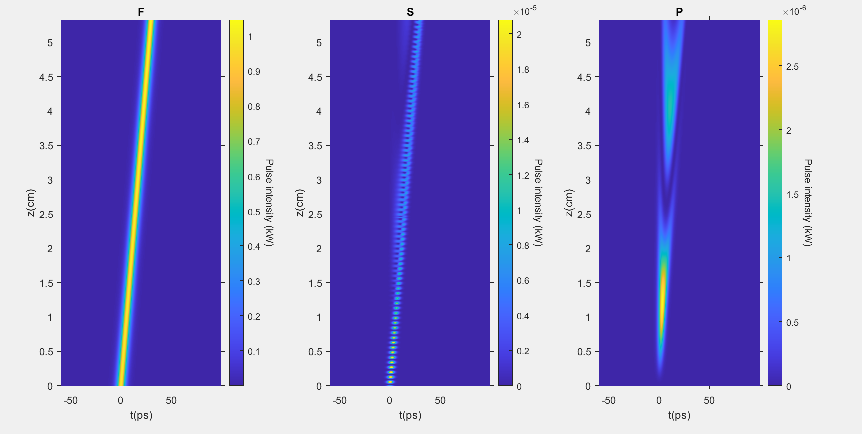

Slide 64


Slide 65


Slide 66


Slide 67
Parameters:
T = 40ps
Beta_f2 = 0.0083 ps^2/cm
Beta_s2 = 0.0022 ps^2/cm
Beta_p2 = 0.0253 ps^2/cm
Beta_f1 = 5.633 ps/cm
Beta_s1 = 5.333 ps/cm
Kappa = 6900, 1/cm
Gamma = 10^1.5, 1/(cm sqrt(kW))
C = 1, 1/cm
A = 1kW
Pulsewidth = 10ps
U0 = Real

Slide 68


Slide 69


Slide 70


Slide 71


